Slide 1


Personas
Making the user real
Lecture /slide deck produced by Saul Greenberg, University of Calgary, Canada
vs
Image from http://3stepsbeyond.co.uk/2011/07/web-personas-this-is-what-weve-done/
Notice: some material in this deck is used from other sources without permission. Credit to the original source is given if it is known,

Slide 2
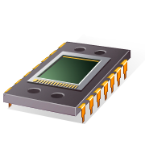
User Interface Design
User Centered Design
User Friendly
Human Computer Interaction…
focused on the user vs system

Slide 3
But who, exactly, is this user?
Image from http://3stepsbeyond.co.uk/2011/07/web-personas-this-is-what-weve-done/

Slide 4

The Elastic User
Can mean everyone and thus no one
  vague audience means unfocussed design
  design defines user after the fact
  lack of specifics means its easy to rationalize any design
image from p.127, The Inmates are Running the Asylum

Slide 5
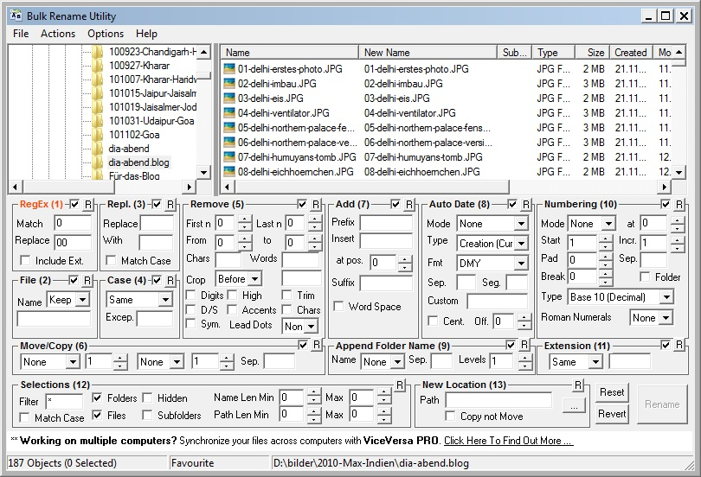
The Elastic User (defined after the fact)
An expert who wants plentiful renaming options
image from http://blog.ideaday.de/max/2010/11/example-for-a-bad-user-interface/

Slide 6

The Elastic User (self-referential)
The user is me (even if he or she isn’t)
image from http://blog.ideaday.de/max/2010/11/example-for-a-bad-user-interface/

Slide 7

The Elastic User (self-referential)
The user is me (even if he or she isn’t)
image from http://aluratek.com/cms/blog/embracing-geekness/

Slide 8
Example
G4K Company
Produces children’s educational and game software
Goal: make a corporate destination site for kids
  child-oriented entertainment
  news
  merchandise related to G4K software
This example and the following images are from: The Persona Lifecycle. John Pruitt and Tamara Adlin. Morgan Kaufmann (Elsevier), 2006

Slide 9
The Elastic User
I’ll gladly surf to your web site
I will love using it
I will buy your stuff
I’ll spend hours navigating your pages
I know how to download software
I have a credit card so I can pay
I am totally nto action games
I like dolls
Parents? What parents?
…

Slide 10
Making the User Real
do they have computers?
how do they use them?
what do they know?
what are their interests?
do they use the web?
what do they like doing online?
…
Captured as Personas

Slide 11
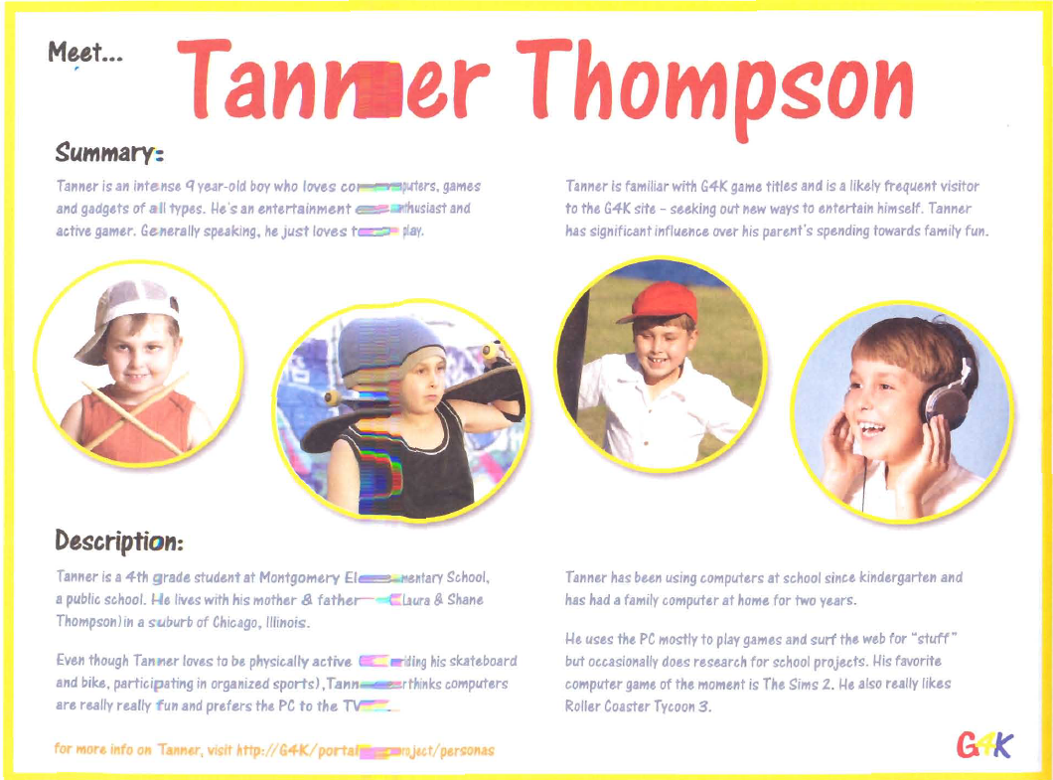

Slide 12
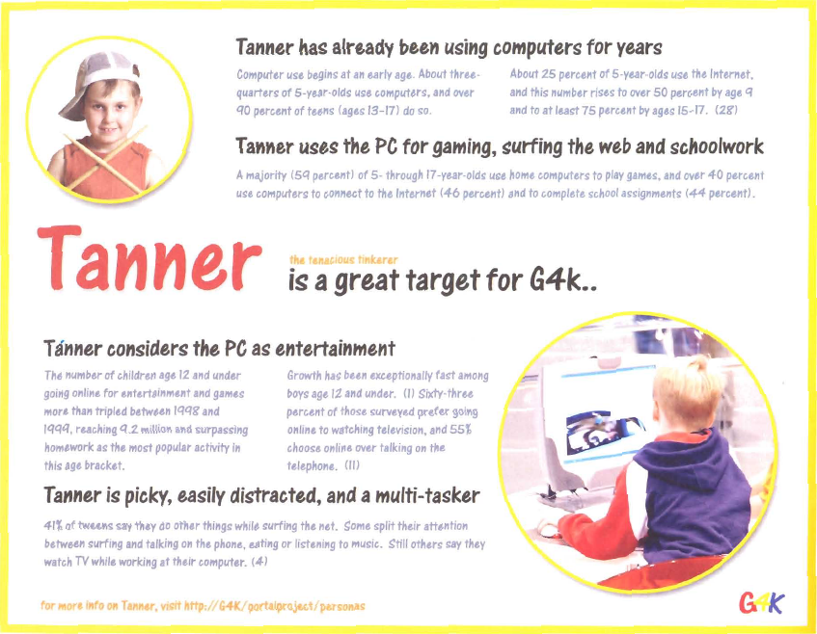

Slide 13
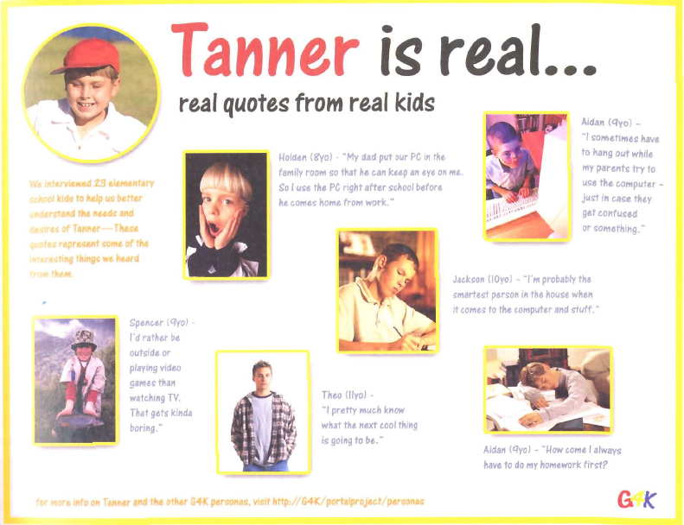

Slide 14
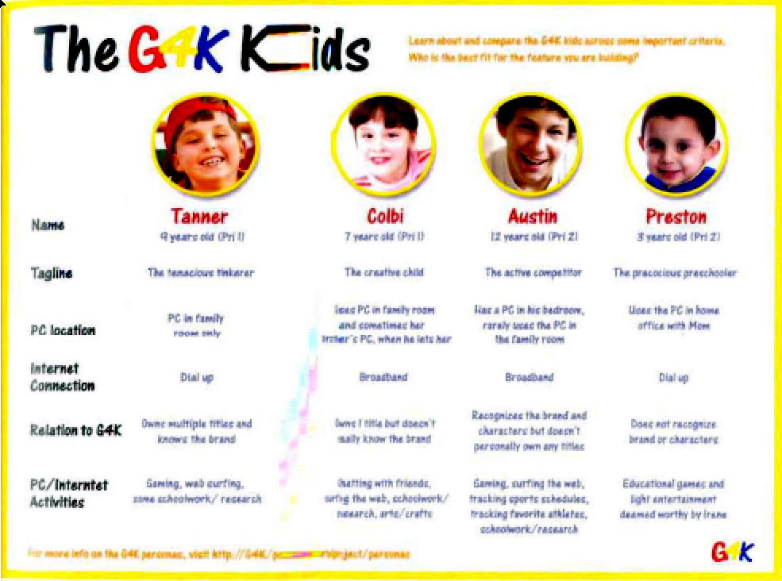

Slide 15
Making the User Real
User requirements analysis
Use Cases
Task centered system design
  provide specifics about particular user’s needs and tasks
  a good start, but can’t anticipate (nor inform) all design decisions

Slide 16
Making the User Real
User research
  gather data about intended audience
How?
  stakeholder interviews
    business and technical context surrounding the product
    preliminary product vision
    budget and schedule
    technical constraints and opportunities
    business driers
    stakeholders’ perception of the user
    …

Slide 17
Making the User Real
User research
  gather data about intended audience
How?
  customer interviews (customer may not be the user!)
    goals in purchasing the product
    frustrations with current solutions
    decision process for purchasing intended product
    role in product installation, maintenance, and management
    domain-related issues and vocabulary
    …

Slide 18
Making the User Real
User research
  gather data about intended audience
How?
  user interviews
    context of how product (or analogous system) fits in their lives or workflow
    their domain knowledge for this activity
    current tasks and activities: that the product is and isn’t supposed to support
    goals and motivations for using this product
    problems and frustrations with current products
    …

Slide 19
Making the User Real
User research
  gather data about intended audience
How?
  user observations
    non-obtrusive capture of specific activities
    how they get things done
  field studies
    capture broader activities
    how activities fit together in their ecosystem
  contextual inquiry
    master/apprentice model of learning
    observing and asking questions
  …

Slide 20
Making the User Real
User research
  gather data about intended audience
Issues?
  rich data, but
    un-integrated
    needs to be interpreted
    high learning curve to assimilate
    too much for ‘casual’ team members to use
    easy to forget over long project
    easy to forget big picture

Slide 21
Making the User Real
Personas
  a surrogate
  based on research
  pseudo-fictional character representing a user archetype
  a composite
  concrete descriptive model of intended user
  as a set, explores ranges of archetypes and behaviours

Slide 22
Personas
Why?
  Precise way of thinking about
    how users behave
    their motivations
    how they think
    what they wish to accomplish (goals)
    why they want to do what they do

Slide 23
Personas
Why?
  Within the team
    provides a shared understanding
    engage in empathy of design towards a target user
    helps communicate who you are building the product for
    helps determines what the product should and shouldn’t do
    serves as a stable reference point during the design process
    provides focus
    a stand-in for actual users
    testable via walkthroughs

Slide 24
Personas
Characteristics
  based on research
  archetypes represented as individual people
  not a real person, but a composite archetype
    each represents groups of users
As a set
  explores ranges of archetypes and behaviours

Slide 25
Persona
Basic structure
  specific narrative
  describes a specific usage pattern
  embodied in a specific fictional user
  by means of text and images
  and based on data
Includes
  name
  photo
  goals
and a mix of
  key characteristics
  motivations
  context
  activities
  narrative story
  representative quotes
  pain points…

Slide 26
Example 1 (by Robert Barlow-Busch)
From:
http://chopsticker.com/2007/06/08/download-an-example-persona-used-in-the-design-of-a-web-application/
ClickDox had an idea that people would be willing to pay for a
web application that lets them
send and receive confidential documents online
as opposed to sending them by courier (too slow and expensive) or as email attachments (too insecure).

Slide 27
Example 1 (by Robert Barlow-Busch)
Data Collection: User interviews
What are people’s overall job goals?
    By understanding what fundamentally motivates people in their jobs, we can design ClickDox’s web application so people feel it contributes to them achieving something important.
2. What’s the context in which they’d use ClickDox?
    By understanding the many factors that influence people on the job, we can design ClickDox so it feels like it was made just for them.
3. What are their current behaviors around document exchange?
    By understanding how people get things done today, we can design ClickDox to help them do it better.

Slide 28
Example 1 (by Robert Barlow-Busch)
Main Discoveries
Security was not as important as had been thought
2. People’s email client was a central tool in their jobs.
3. All struggled with large files that exceeded the mailer’s size limit
Result
Original strategy stressed security.
New result stressed ease of sending large files

Slide 29
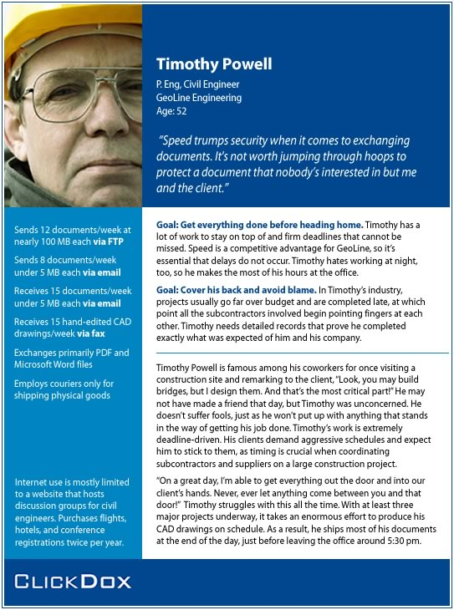

Slide 30
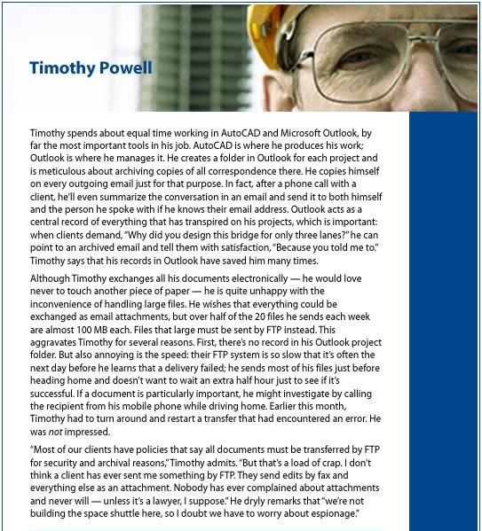

Slide 31
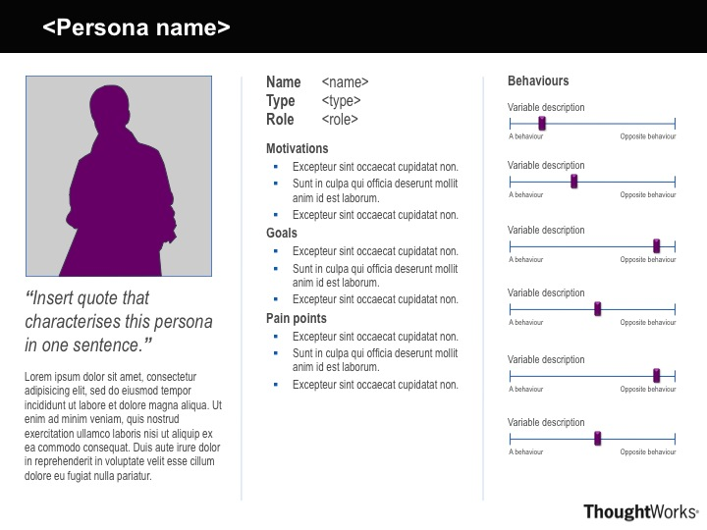
A Persona Template by Ben Melbourne from http://asinthecity.com/2011/05/13/explaining-personas-used-in-ux-design-%E2%80%93-part-2/

Slide 32
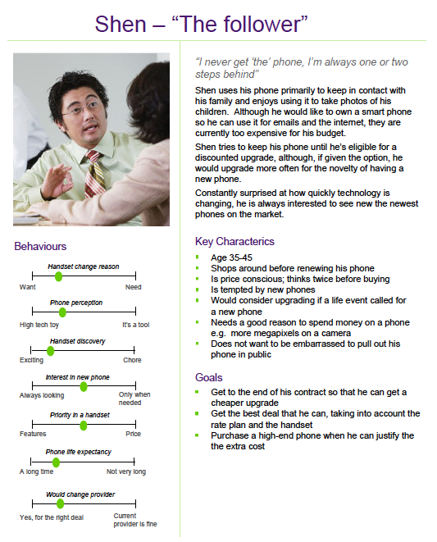
Handset upgrades
Persona Examples by Ben Melbourne
http://asinthecity.com/2011/05/13/explaining-personas-used-in-ux-design-%E2%80%93-part-2/

Slide 33
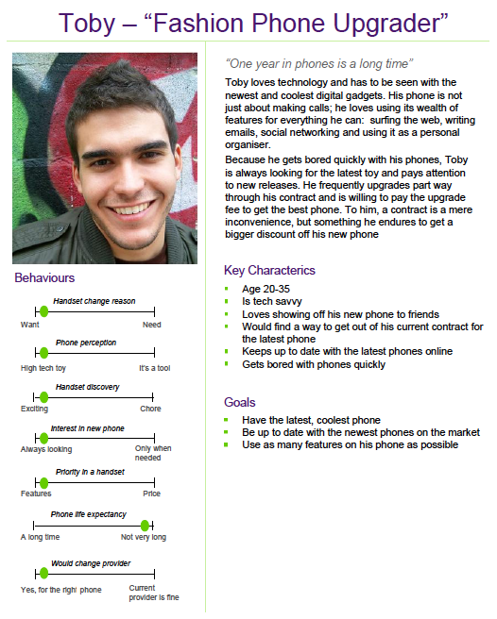
Handset upgrades
Persona Examples by Ben Melbourne
http://asinthecity.com/2011/05/13/explaining-personas-used-in-ux-design-%E2%80%93-part-2/

Slide 34
You now know
1. The Elastic User is problematic
2. Good Design requires Making the User Real
3. Personas define ‘real’ Archetype Users
4. Personas
  use the design funnel to develop ideas with
  the best ones considered for green/red light appraisal

Slide 35
Sources and Further References
The Inmates are Running the Asylum. Alan Cooper.
Sams, 1999 (Chapter 9)
About Face 3. Alan Cooper, Robert Reimann & David Cronin.
Wiley Publishing, 2007 (Chapters 4 & 5)
The Persona Lifecycle. John Pruitt and Tamara Adlin.
Morgan Kaufmann (Elsevier), 2006
Using Personas. Slide deck by Andrea Resmini:
http://www.slideshare.net/resmini/personas-5431493?from=share_email

Slide 36



Permissions
You are free:
  to Share — to copy, distribute and transmit the work
  to Remix — to adapt the work
Under the following conditions:
Attribution — You must attribute the work in the manner specified by the author (but not in any way that suggests that they endorse you or your use of the work) by citing:
  “Lecture materials by Saul Greenberg, University of Calgary, AB, Canada. http://saul.cpsc.ucalgary.ca/saul/pmwiki.php/HCIResources/HCILectures”
Noncommercial — You may not use this work for commercial purposes, except to assist one’s own teaching and training within commercial organizations.
Share Alike — If you alter, transform, or build upon this work, you may distribute the resulting work only under the same or similar license to this one.
With the understanding that:
Not all material have transferable rights — materials from other sources which are included here are cited
Waiver — Any of the above conditions can be waived if you get permission from the copyright holder.
Public Domain — Where the work or any of its elements is in the public domain under applicable law, that status is in no way affected by the license.
Other Rights — In no way are any of the following rights affected by the license:
  Your fair dealing or fair use rights, or other applicable copyright exceptions and limitations;
  The author's moral rights;
  Rights other persons may have either in the work itself or in how the work is used, such as publicity or privacy rights.
Notice — For any reuse or distribution, you must make clear to others the license terms of this work. The best way to do this is with a link to this web page.

