Slide 1
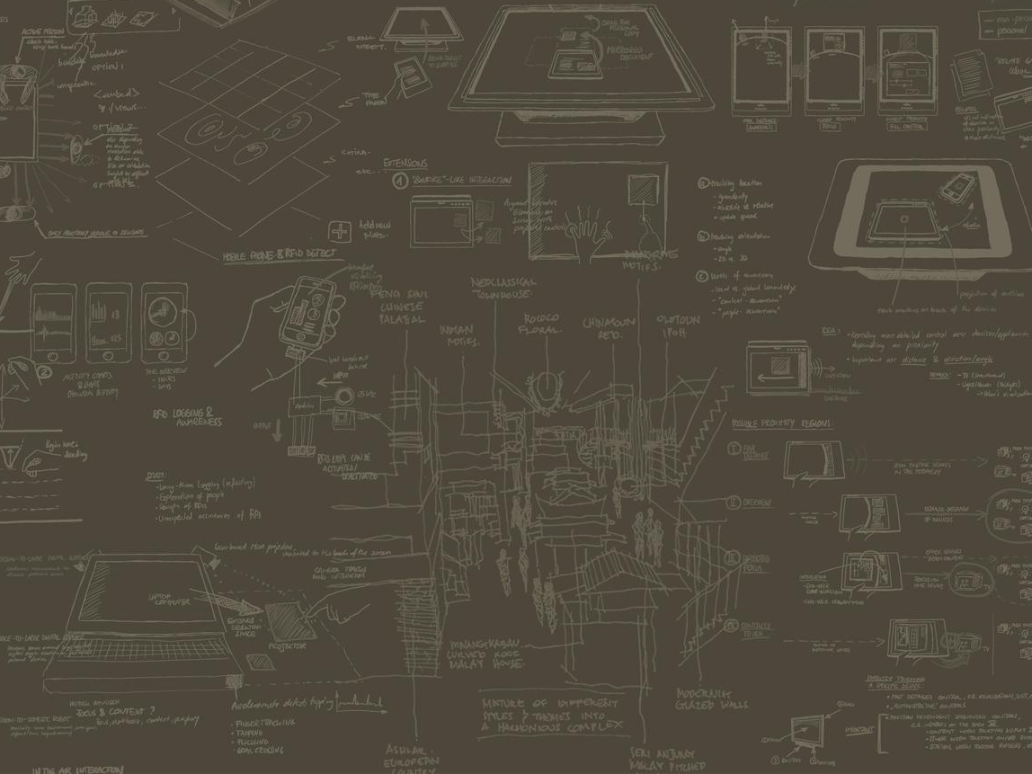


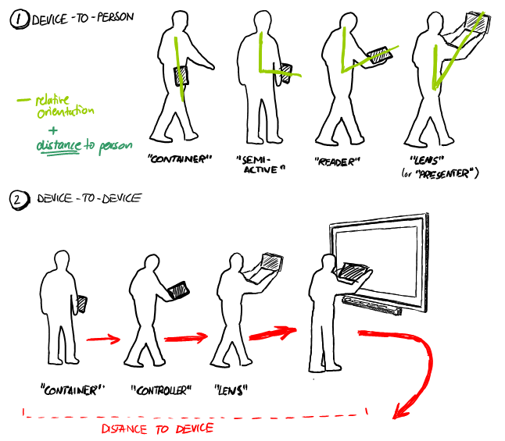
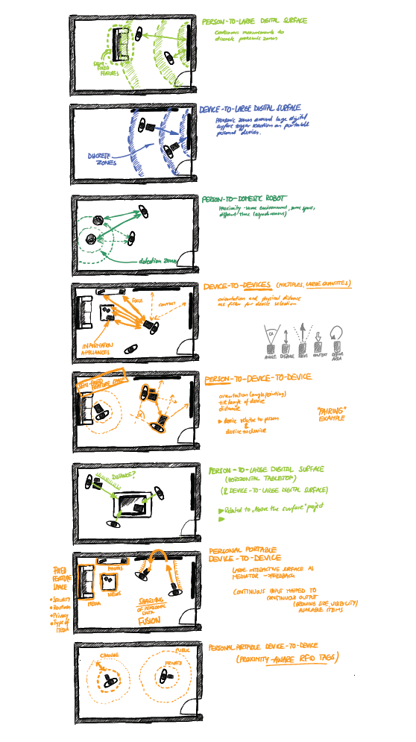
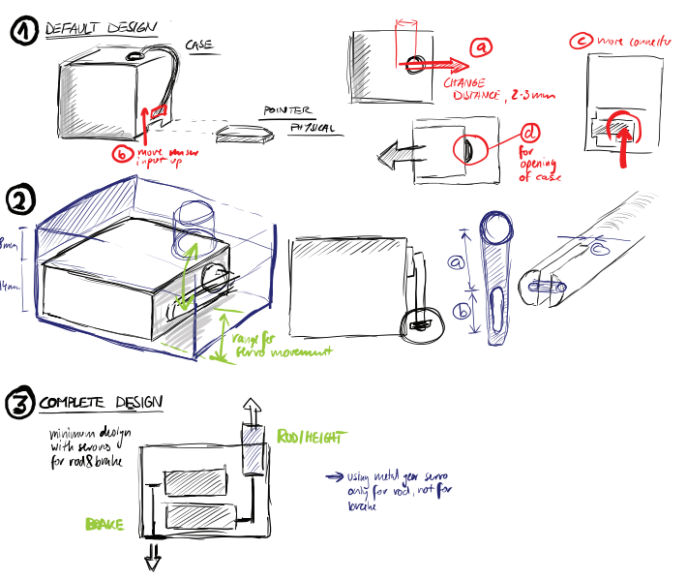
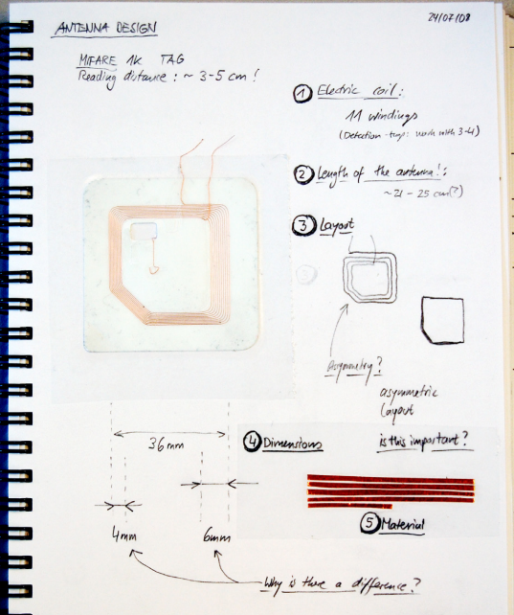
SKETCHING USER
EXPERIENCES
STORIES
STRATEGIES
SURFACES
Nicolai Marquardt
Interactions Lab | University of Calgary
Tutorial at SMART Technologies, 2012

Slide 2
SKETCHING USER
EXPERIENCES

Slide 3
SKETCHING USER
EXPERIENCES
STORIES
STRATEGIES
SURFACES

Slide 4
SKETCHING USER
EXPERIENCES
STORIES
STRATEGIES
SURFACES

Slide 5
SKETCHING USER
EXPERIENCES
STORIES
STRATEGIES
SURFACES

Slide 6
SKETCHING USER
EXPERIENCES
STORIES
STRATEGIES
SURFACES

Slide 7
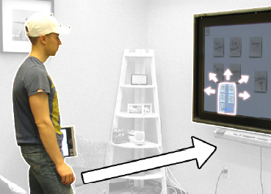
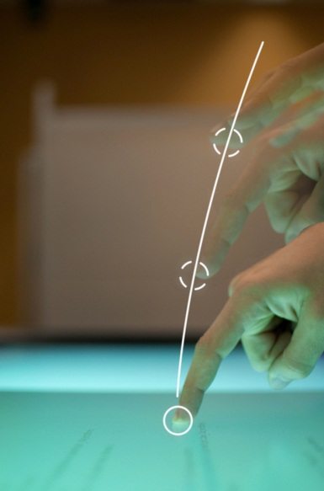
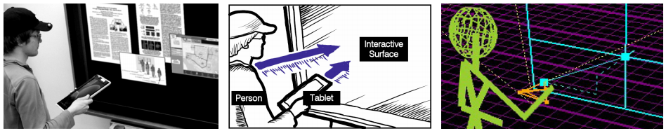

Slide 8
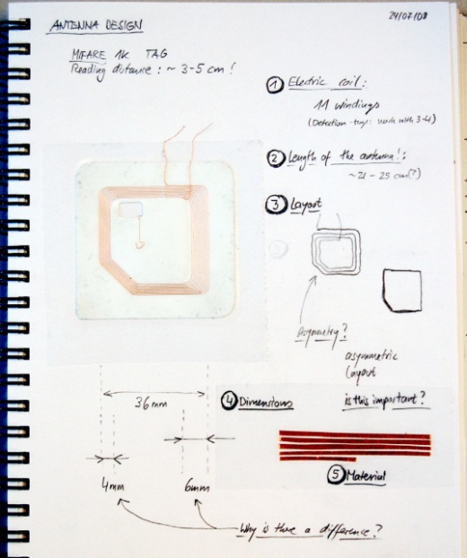

Slide 9
hands-on sketching throughout the talk

Slide 10
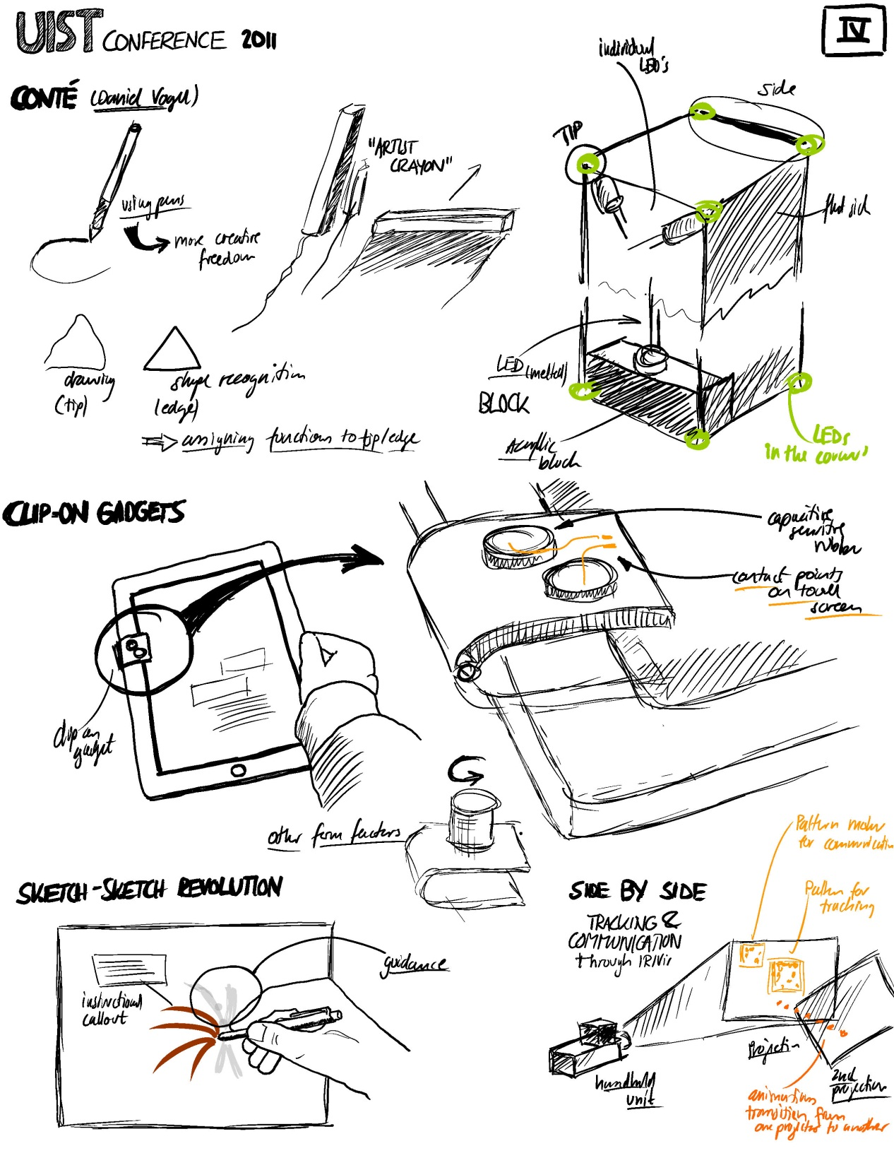
filling the blank page…

Slide 12
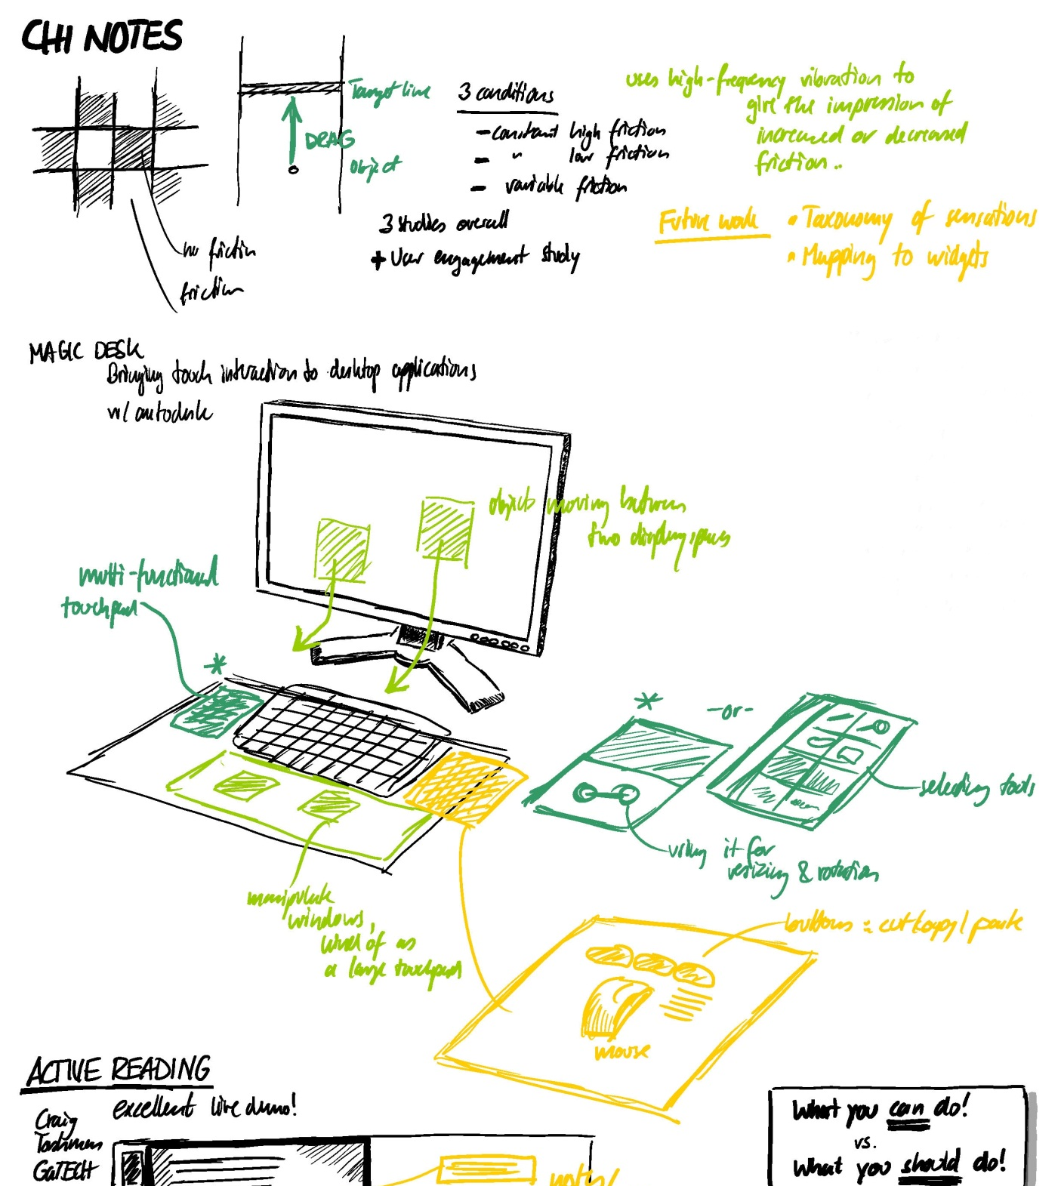

Slide 13
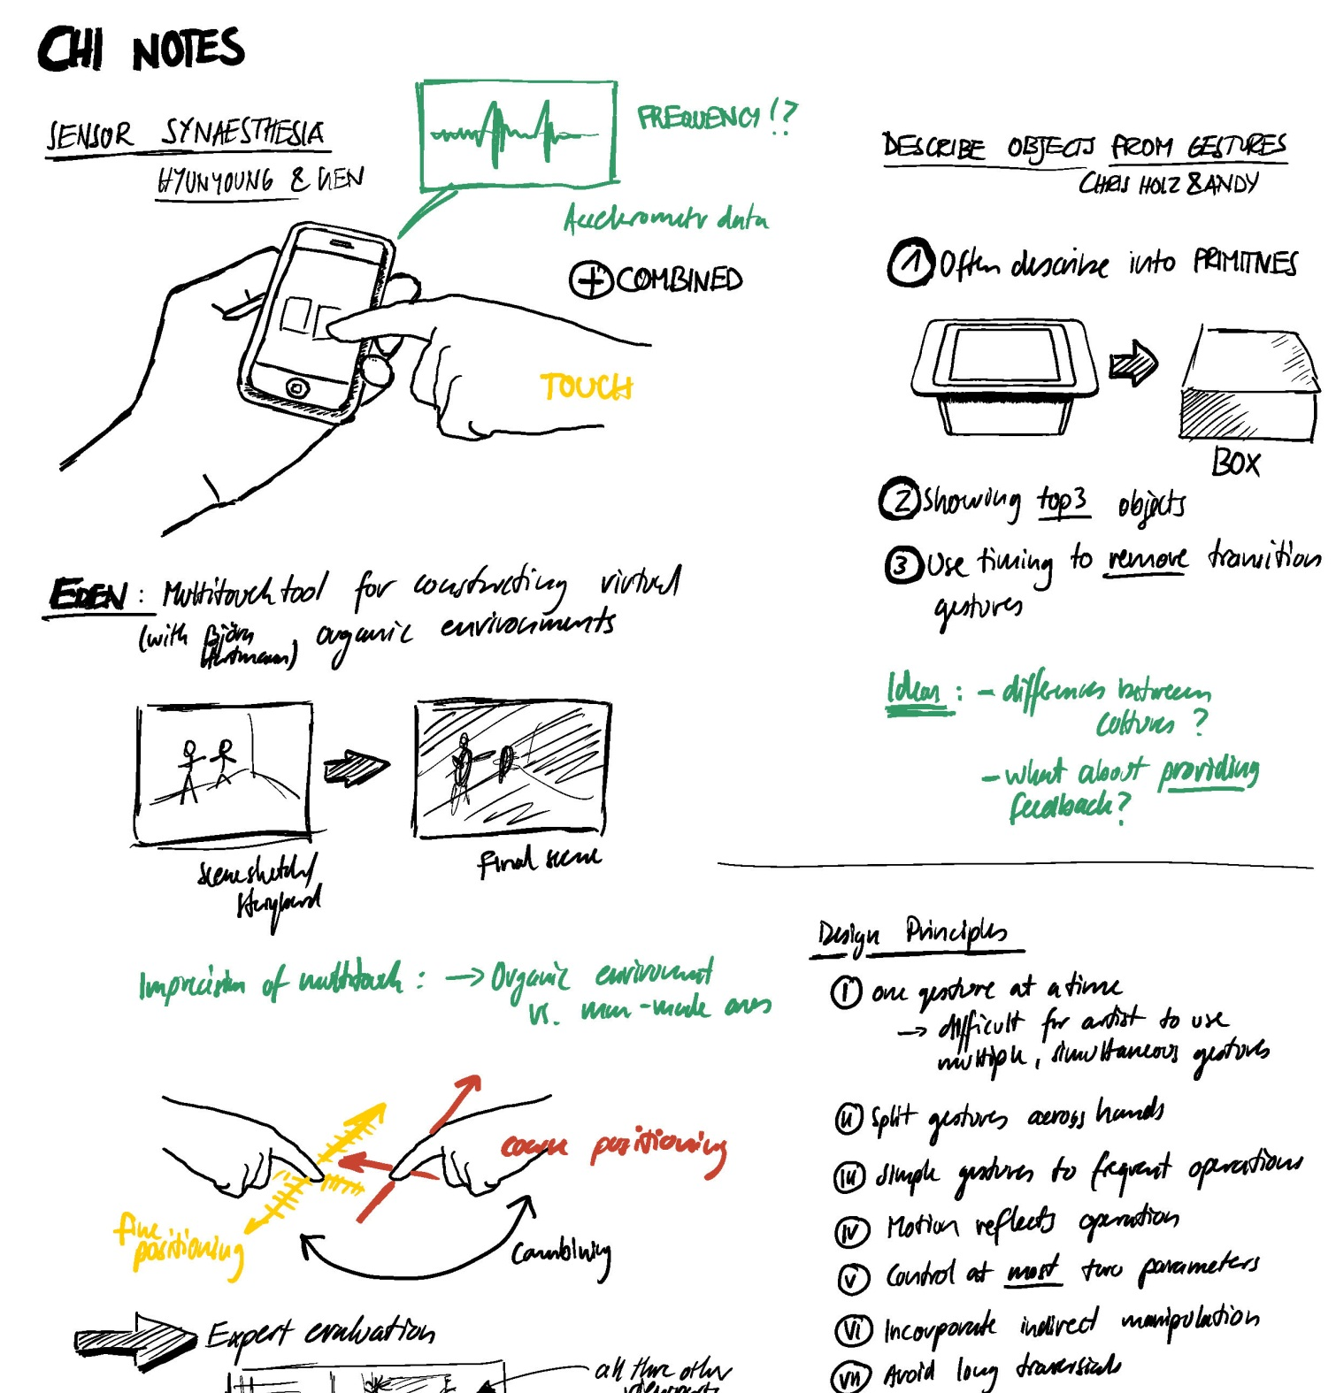

Slide 14
SKETCHING USER
EXPERIENCES
STORIES
STRATEGIES
SURFACES

Slide 15
getting the design right vs. getting the right design
Bill Buxton

Slide 16
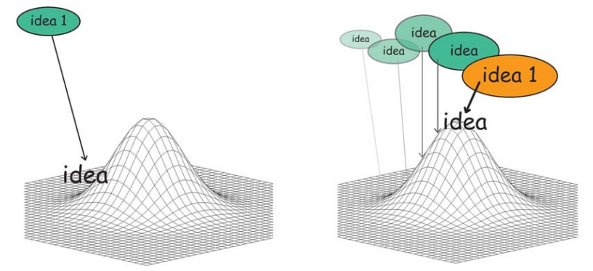
Getting the design right

Slide 17
Getting the design right

Slide 18
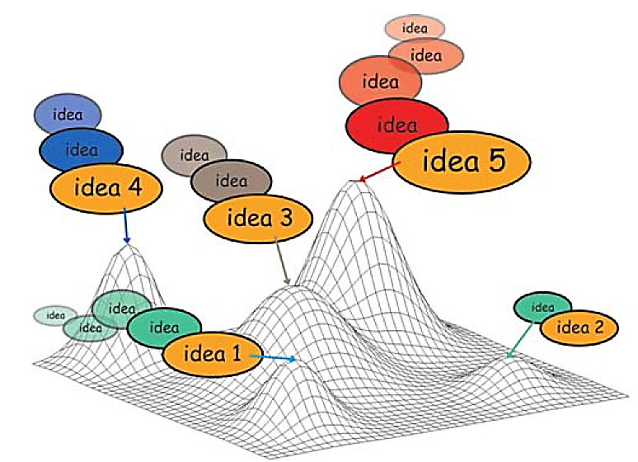
Instead: Getting the right design

Slide 19
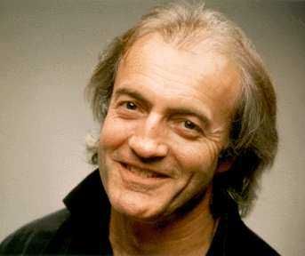

Slide 20
Plentiful
Timely, when needed
Inexpensive and disposable
Clear vocabulary and distinct gesture
Minimal detail and appropriate refinement
Ambiguous
Quick to make
Suggest and explore rather than confirm

Slide 21
A peek into eight inspiring sketchbooks...

Slide 22
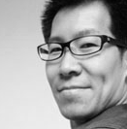
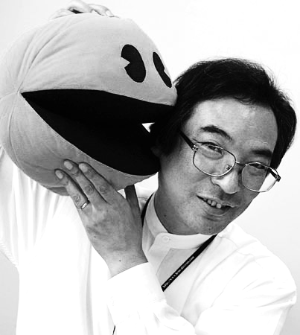
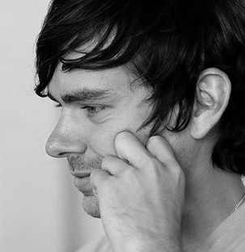
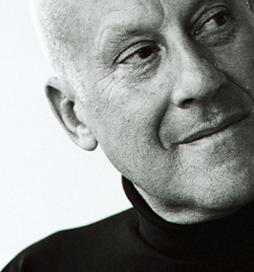
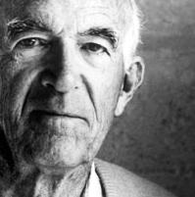
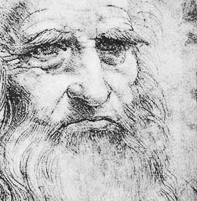
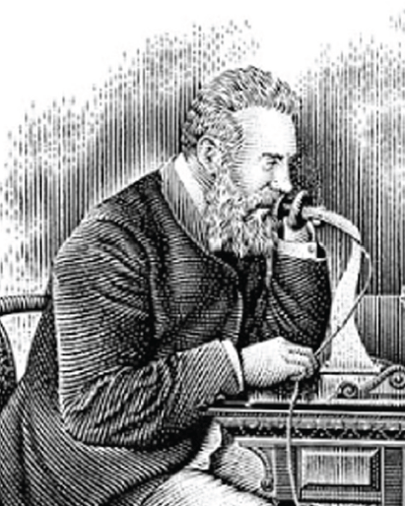
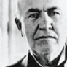
A peek into eight inspiring sketchbooks...

Slide 23
1
Carl Liu | Product Designer

Slide 24
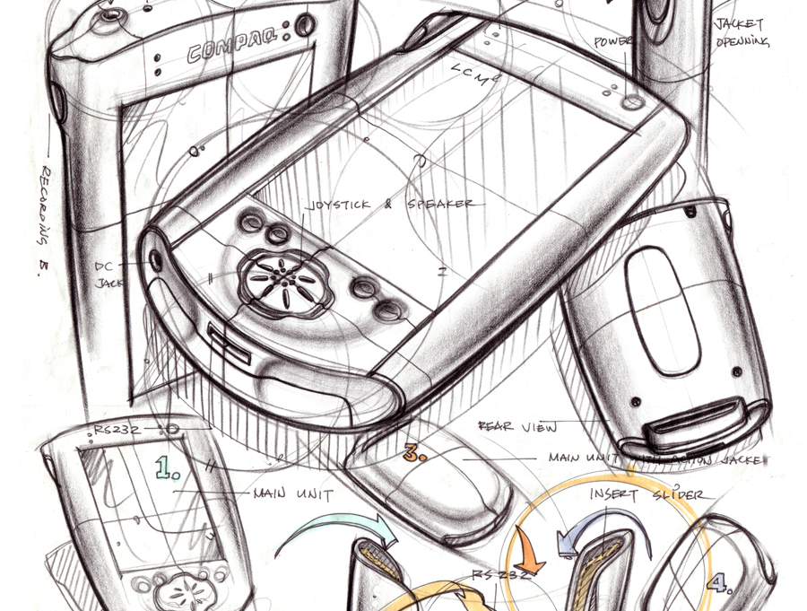
Source: Carl Liu

Slide 25
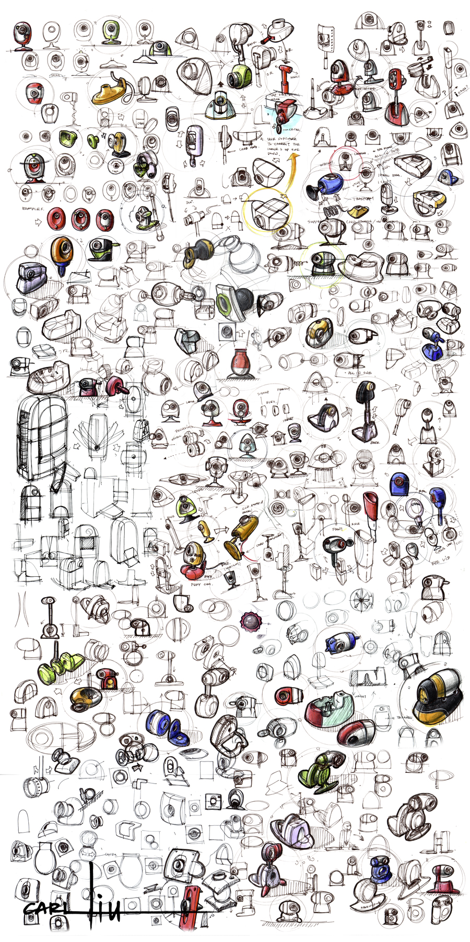

Slide 26
Source: Carl Liu

Slide 27
Source: Carl Liu

Slide 28
Source: Carl Liu

Slide 29
Source: Carl Liu

Slide 31
Plentiful

Slide 32
Source: Carl Liu

Slide 33
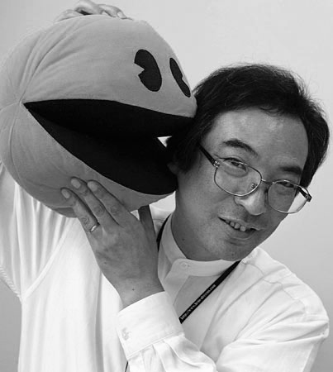
2
Toru Iwatani | Designer

Slide 34
2
Toru Iwatani | Game Designer

Slide 35
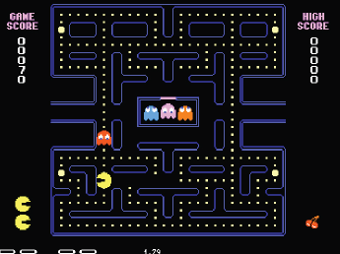

Slide 36
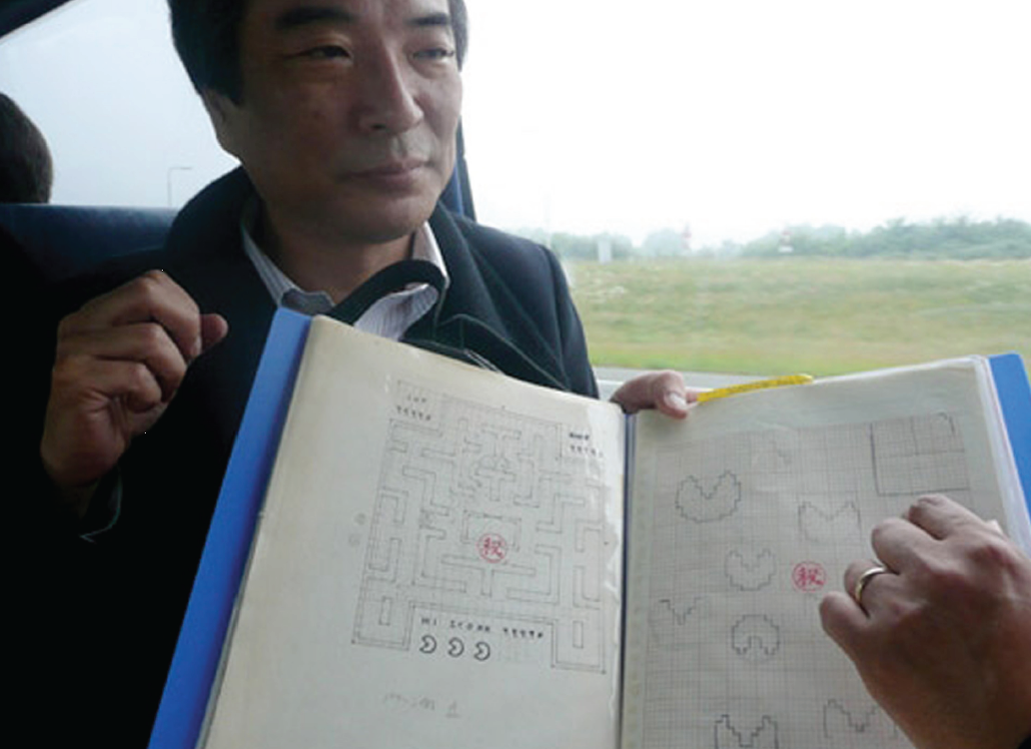
Source: Toru Iwatani, control-online.nl

Slide 37
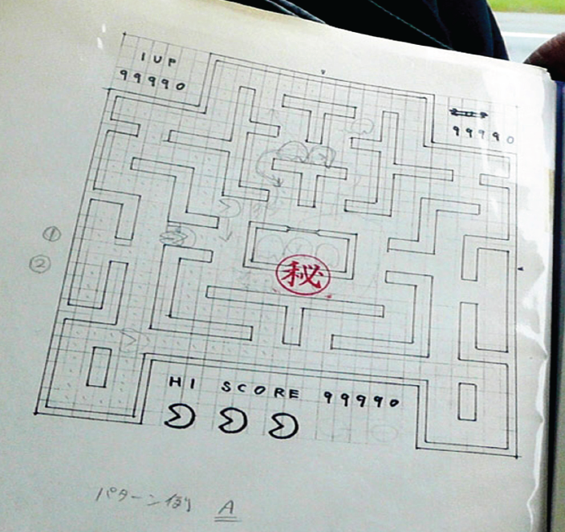
Source: Toru Iwatani, control-online.nl

Slide 38
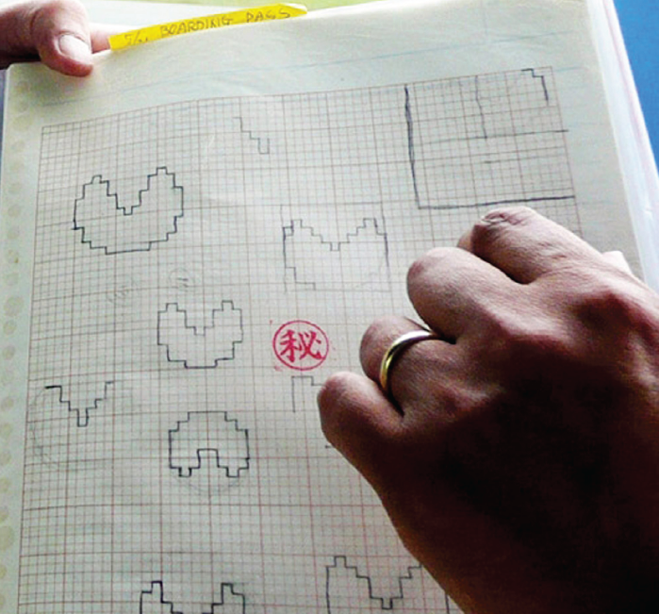
Source: Toru Iwatani, control-online.nl

Slide 39
Timely

Slide 40
3
Jack Dorsey | Software Architect

Slide 41


Slide 42
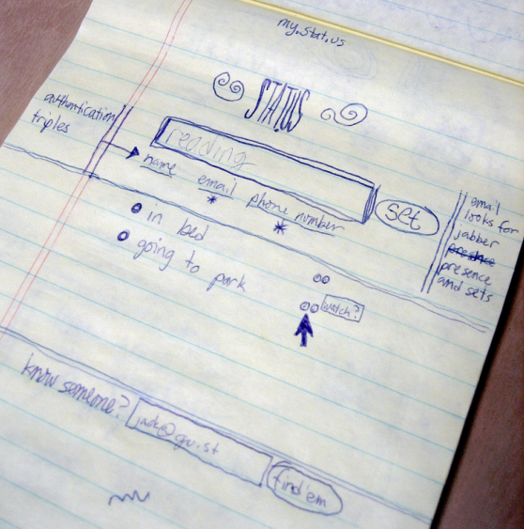
Source: Jack Dorsey
http://www.flickr.com/
photos/jackdorsey/
182613360/

Slide 43
Inexpensive and disposable

Slide 44
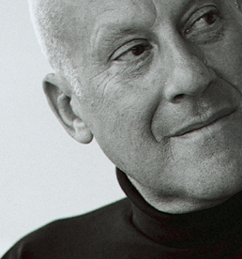
4
Sir Norman Foster | Architect

Slide 45
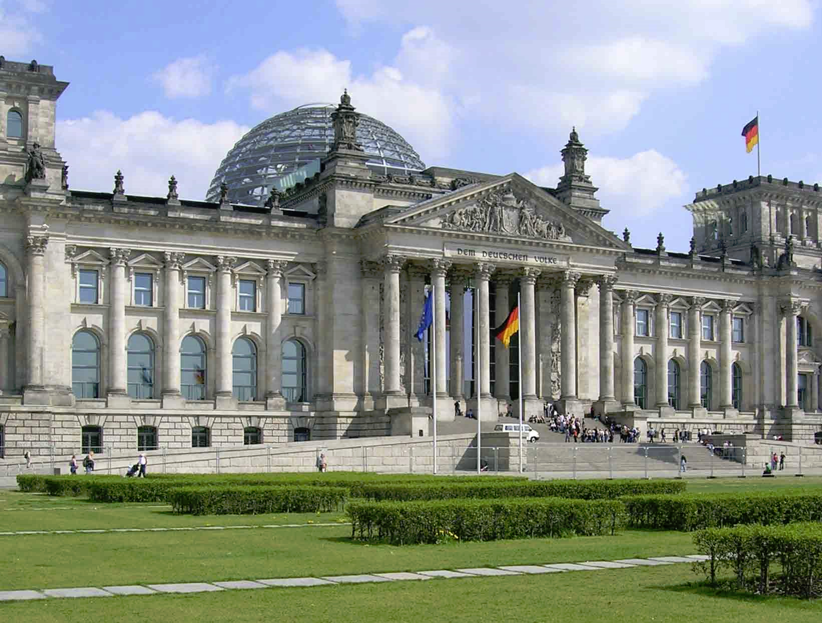

Slide 46
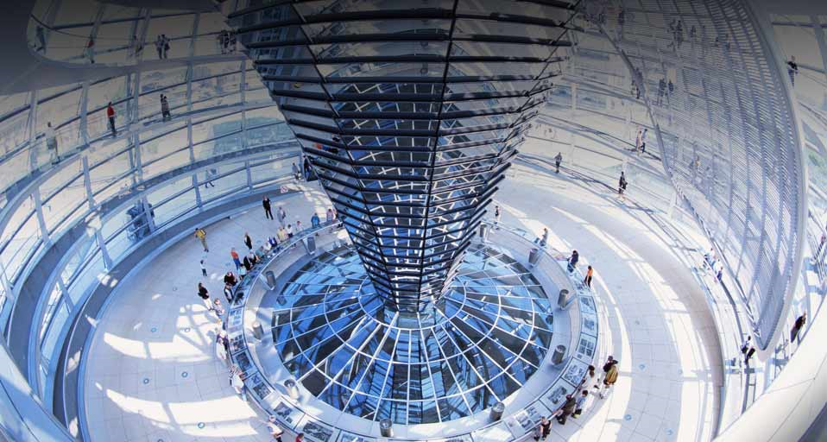

Slide 47
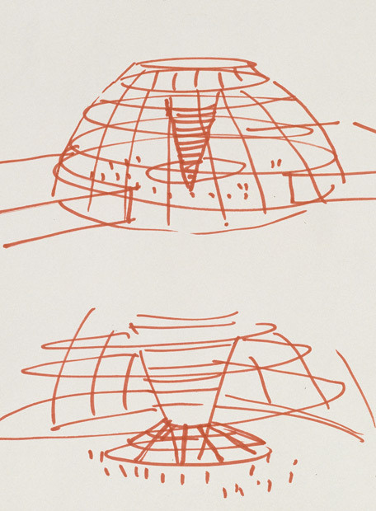
Source: Norman Foster

Slide 48
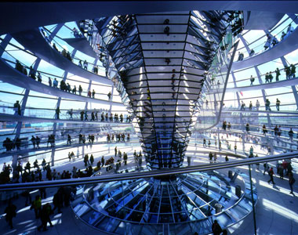
Source: Norman Foster

Slide 49
Clear vocabulary and distinct gesture

Slide 50
Source: Norman Foster

Slide 51
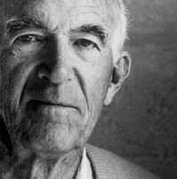
5
Jørn Utzon | Architect

Slide 52
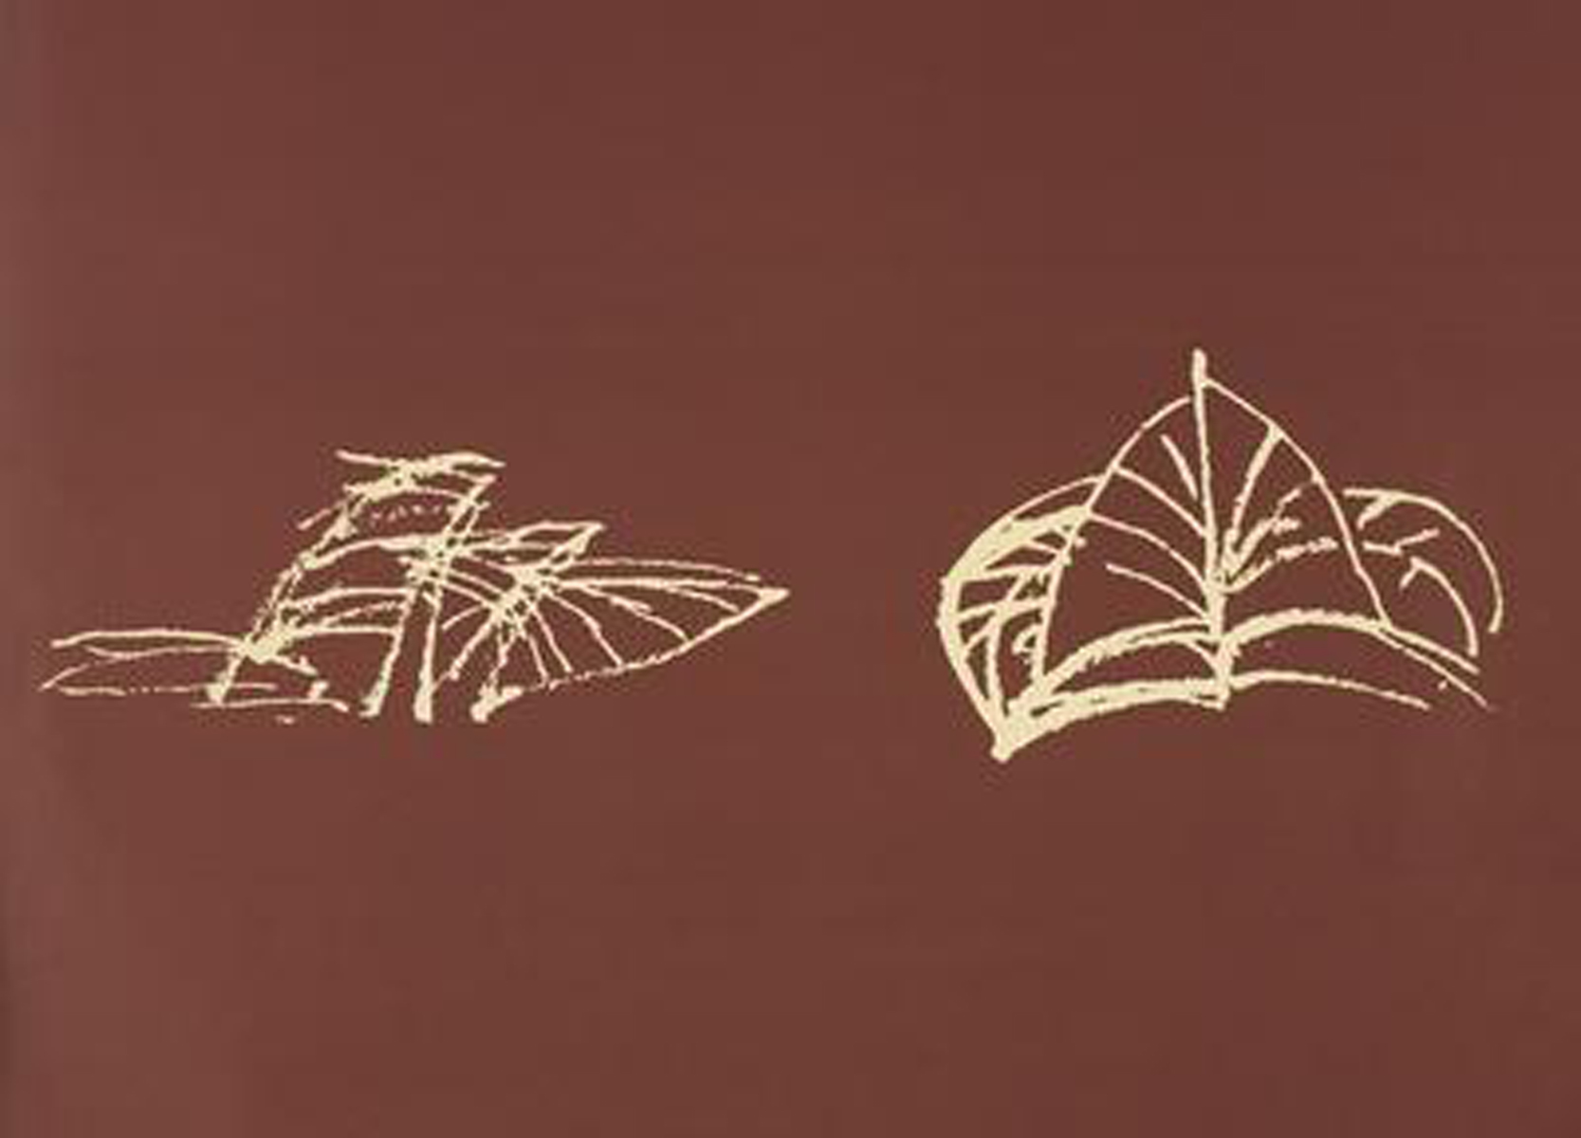
Source: Jørn Utzon

Slide 53
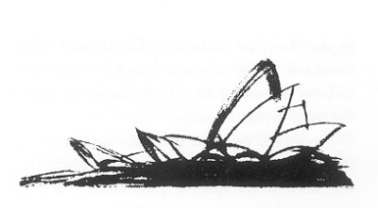
Source: Jørn Utzon

Slide 54
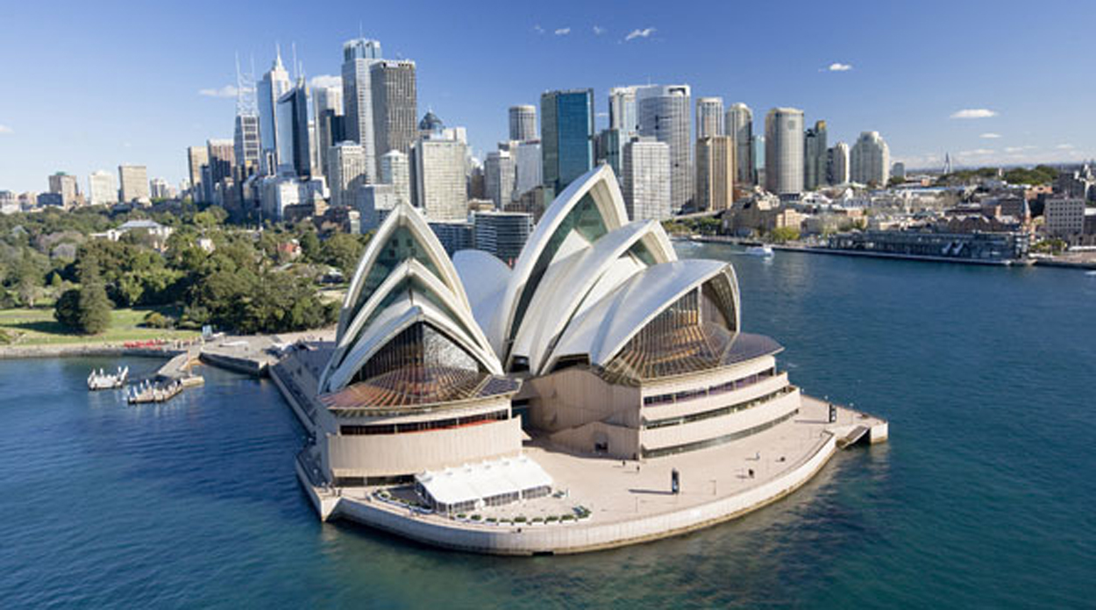

Slide 55
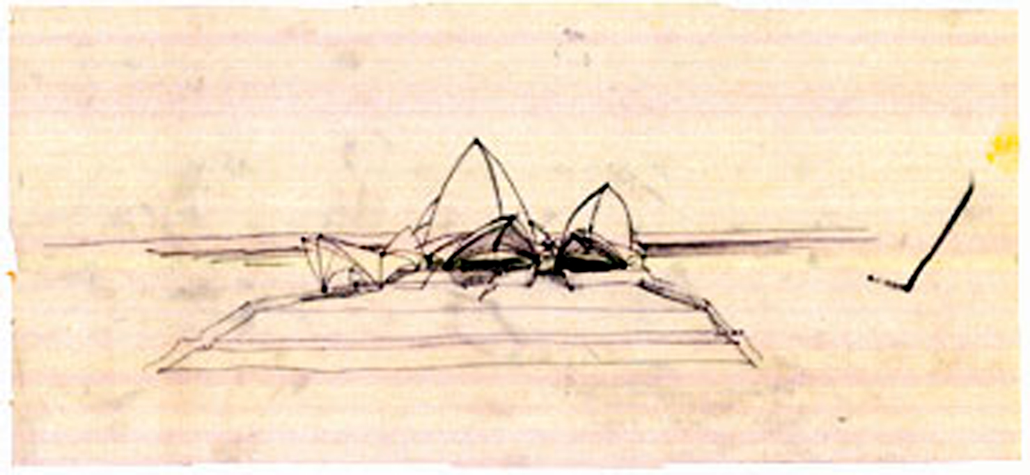
Source: Jørn Utzon

Slide 56
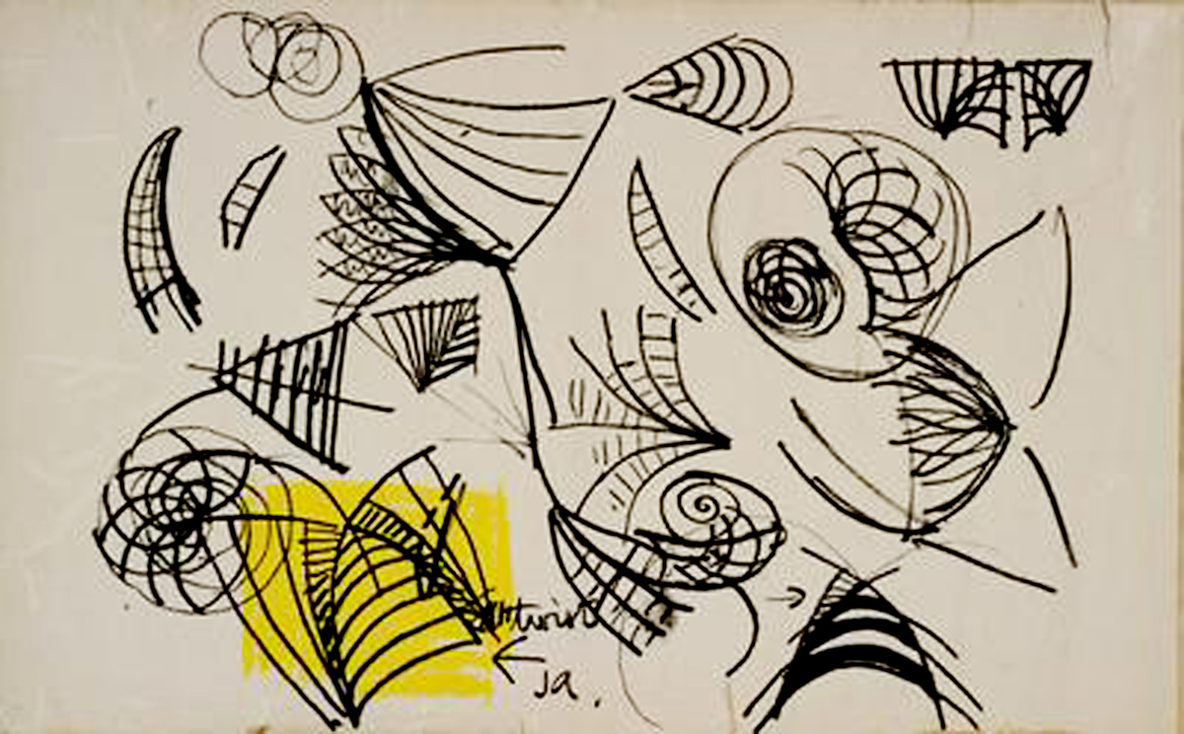
Source: Jørn Utzon

Slide 57
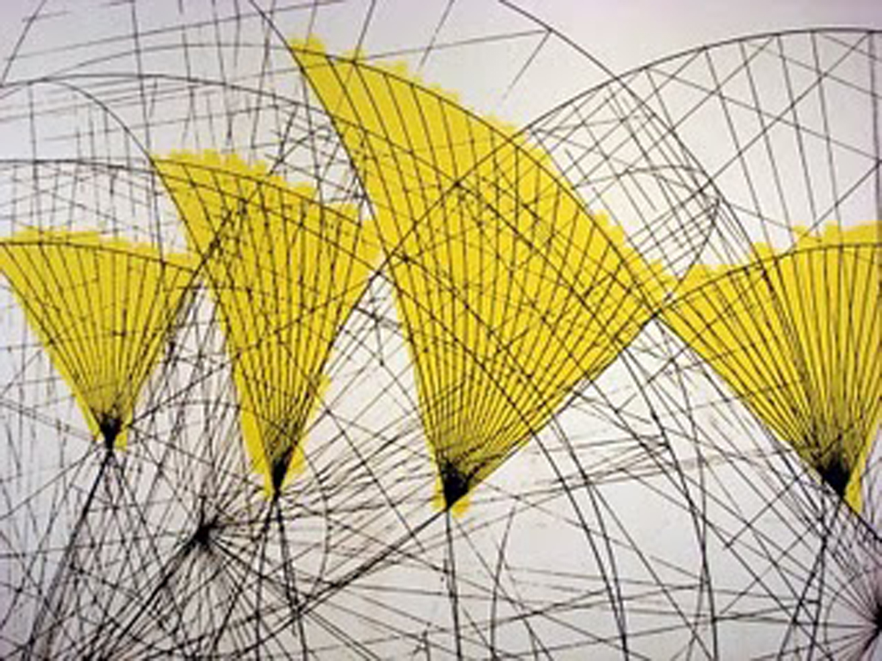
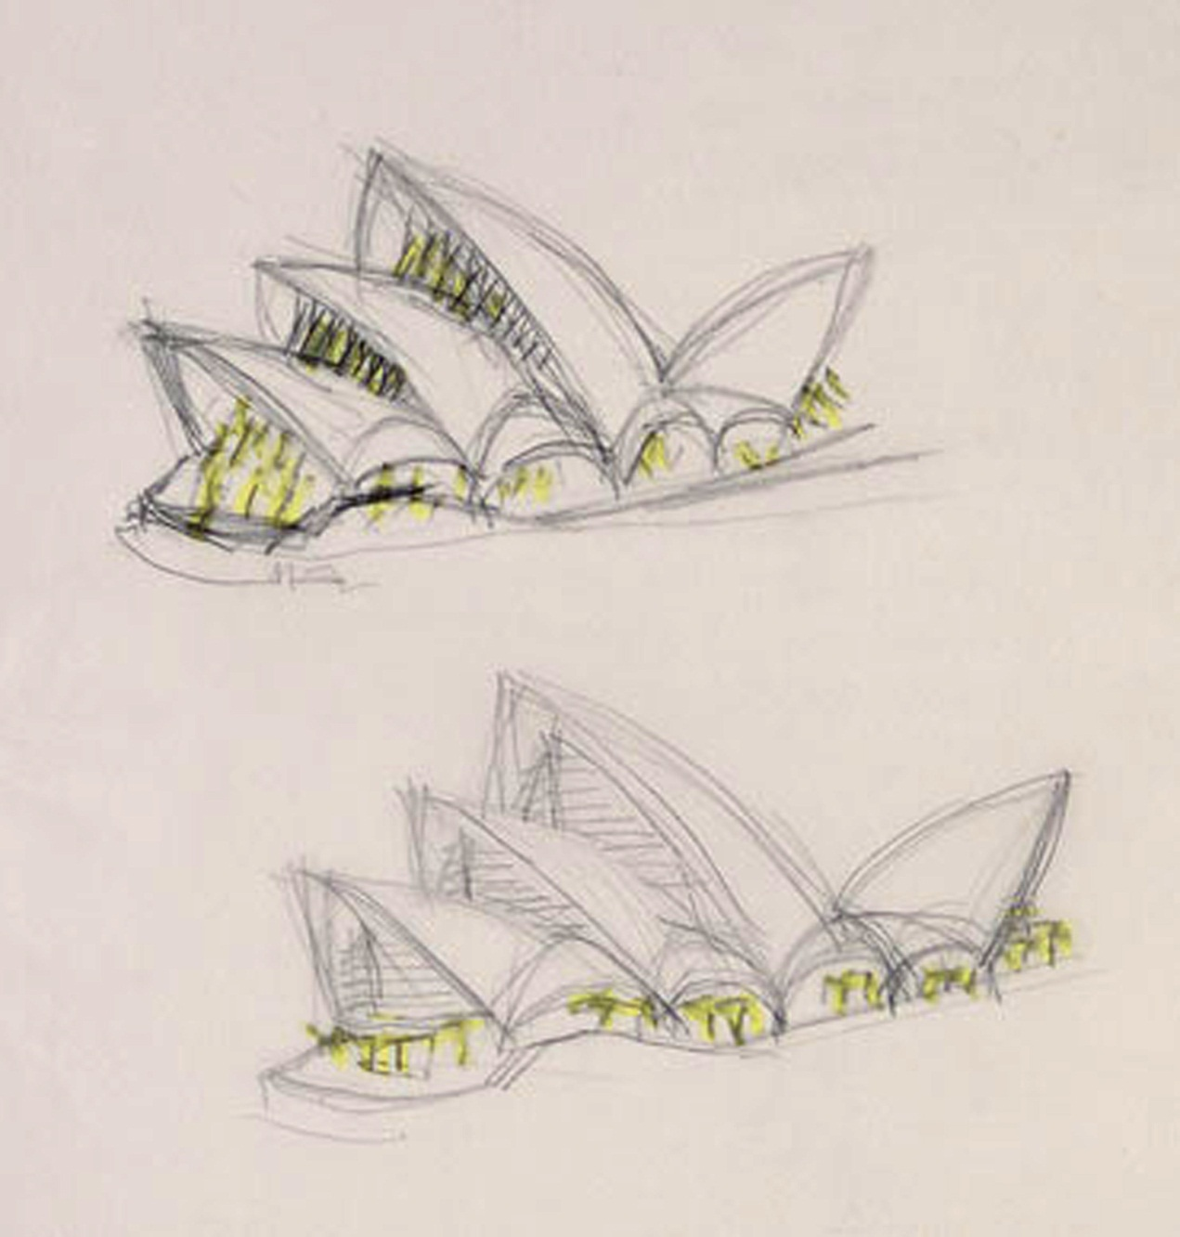
Source: Jørn Utzon

Slide 58
Minimal detail and appropriate refinement

Slide 59
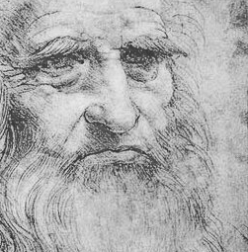
6
Leonardo da Vinci | Scientist, Artist,...

Slide 60
6
Leonardo da Vinci | Scientist, Artist,
Architect, Writer, Sculptor, Musician, Engineer, Mathematician, Inventor, Botanist, Anatomist, Cartographer, …

Slide 61
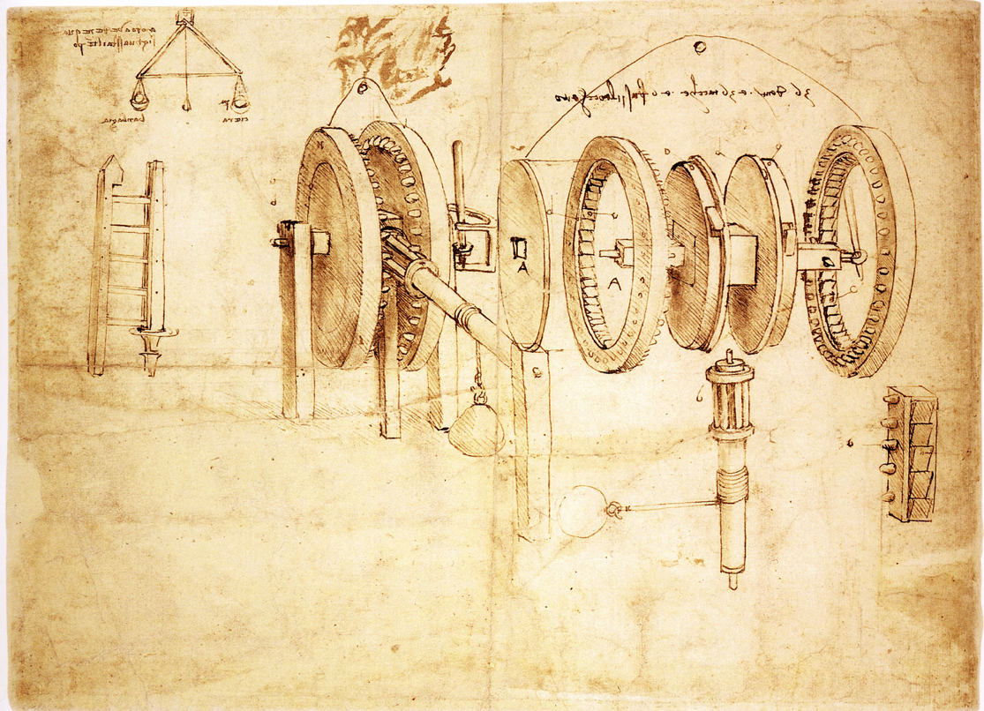

Slide 62
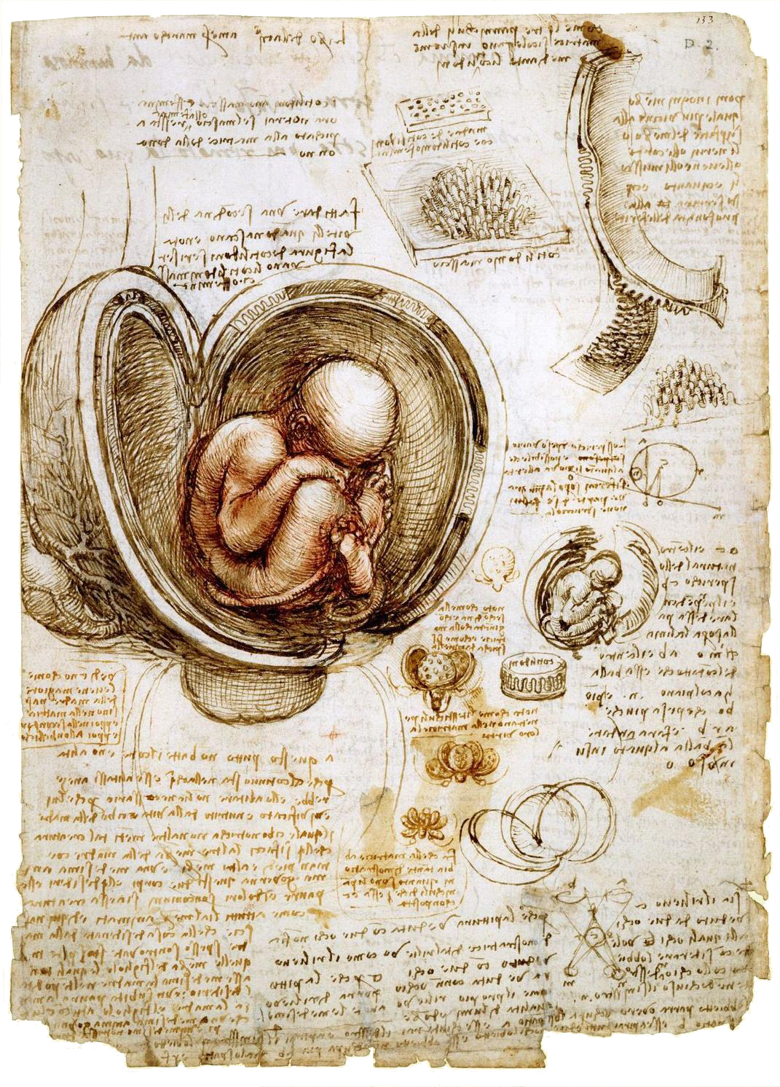

Slide 63
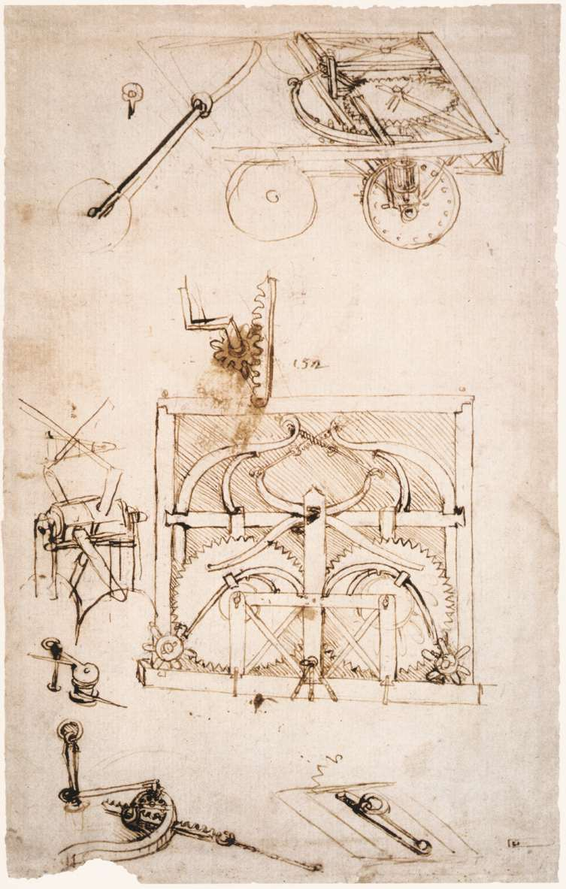
Source: British Library
http://www.bl.uk/onlinegallery/ttp/ttpbooks.html

Slide 64
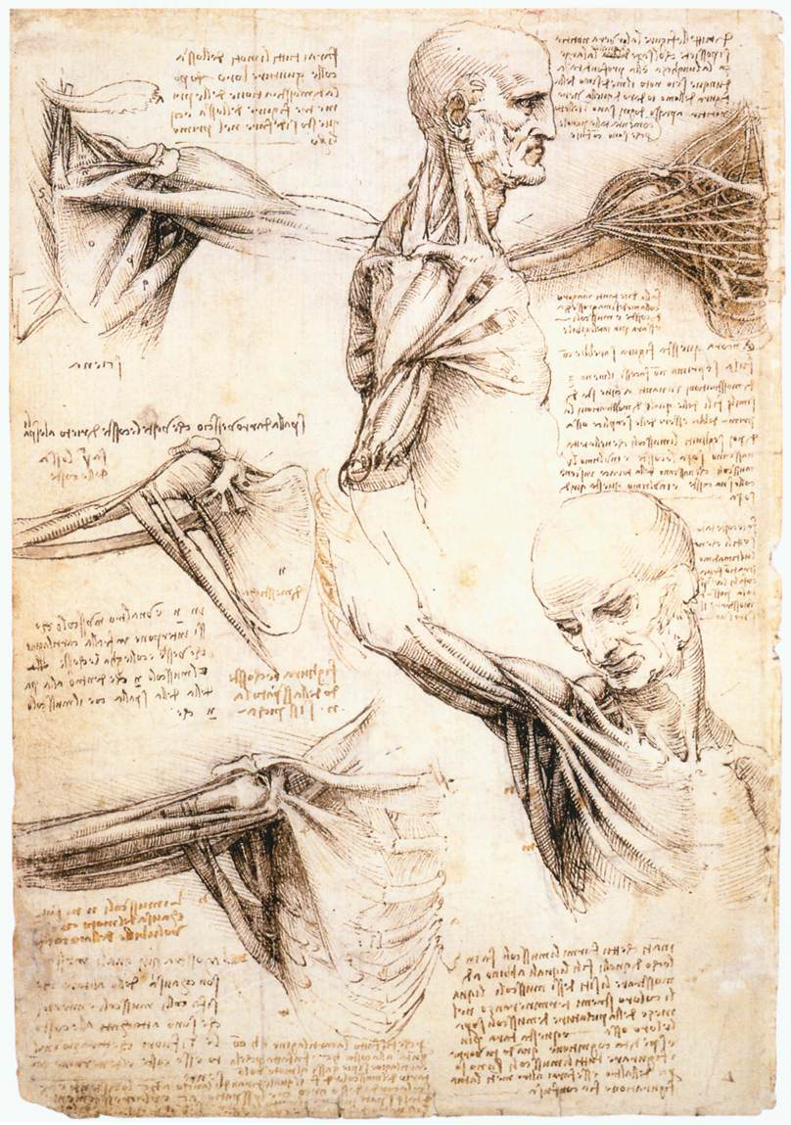


Slide 65
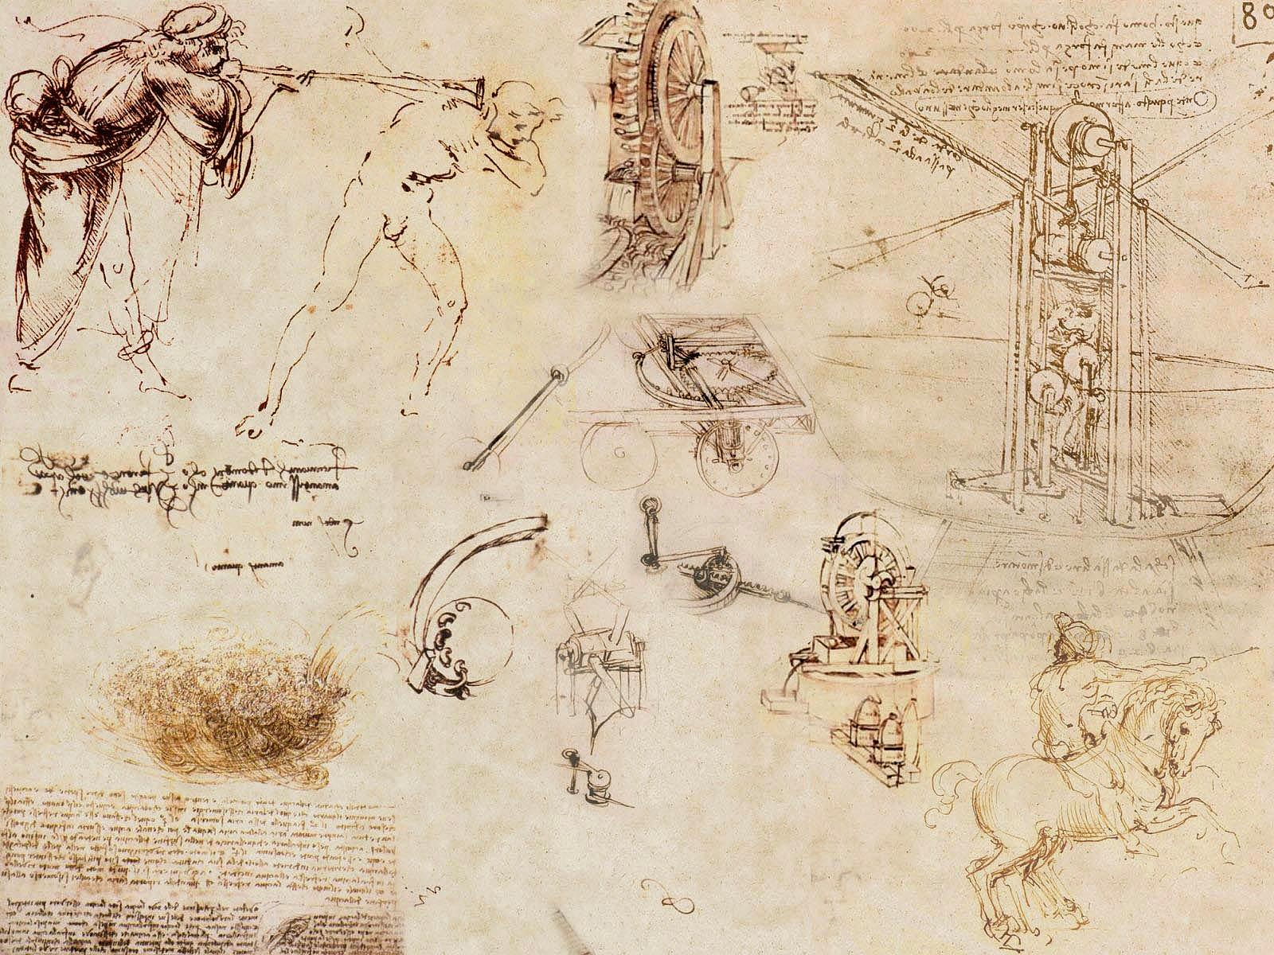

Slide 66
Ambiguous

Slide 67



Mariano Taccola | Scientist
Source: Kinematic models
for design digital library
http://kmoddl.library.cornell.edu/

Slide 68
7
Alexander G. Bell | Engineer, Inventor

Slide 69


Slide 70


Source: The Library of Congress
http://memory.loc.gov/ammem/bellhtml/bellhome.html/

Slide 71

Source: The Library
of Congress
http://memory.loc.gov/ammem/bellhtml/bellhome.html/

Slide 72
Source: The Library
of Congress
http://memory.loc.gov/ammem/bellhtml/bellhome.html/

Slide 73
Quick to make

Slide 74

8
Thomas Alva Edison | Inventor

Slide 75


Slide 76

Source: The Thomas Edison Papers, Rutgers University
http://edison.rutgers.edu/

Slide 77

Source: The Thomas Edison Papers, Rutgers University
http://edison.rutgers.edu/

Slide 78

Source: The Thomas Edison Papers, Rutgers University
http://edison.rutgers.edu/

Slide 79


Source: The Thomas Edison Papers, Rutgers University
http://edison.rutgers.edu/

Slide 80

Source: The Thomas Edison Papers, Rutgers University
http://edison.rutgers.edu/

Slide 81

Source: The Thomas Edison Papers, Rutgers University
http://edison.rutgers.edu/

Slide 82

Source: The Thomas Edison Papers, Rutgers University
http://edison.rutgers.edu/

Slide 83

Source: The Thomas Edison Papers, Rutgers University
http://edison.rutgers.edu/

Slide 84


Source: The Thomas Edison Papers, Rutgers University
http://edison.rutgers.edu/

Slide 85
Suggest and explore rather than confirm

Slide 86
Edison and his staff
created over
2,500
notebooks with
200-300 pages each

Slide 88
Quickly back to the properties of sketches…

Slide 89
Quick to make
Timely
Inexpensive
Disposable
Plentiful
Clear vocabulary
Distinct gesture
Minimal detail
Appropriate degree of refinement
Suggest and explore rather than confirm
Ambiguity

Slide 90
Quick to make
Timely
Inexpensive
Disposable
Plentiful
Clear vocabulary
Distinct gesture
Minimal detail
Appropriate degree of refinement
Suggest and explore rather than confirm
Ambiguity

Slide 91
Quick to make
Timely
Inexpensive
Disposable
Plentiful
Clear vocabulary
Distinct gesture
Minimal detail
Appropriate degree of refinement
Suggest and explore rather than confirm
Ambiguity

Slide 92

Quick to make
Timely
Inexpensive
Disposable
Plentiful
Clear vocabulary
Distinct gesture
Minimal detail
Appropriate degree of refinement
Suggest and explore rather than confirm
Ambiguity

Slide 93
Quick to make
Timely
Inexpensive
Disposable
Plentiful
Clear vocabulary
Distinct gesture
Minimal detail
Appropriate degree of refinement
Suggest and explore rather than confirm
Ambiguity

Slide 94
SKETCHING USER
EXPERIENCES
STORIES
STRATEGIES
SURFACES

Slide 95
Sketches do not have to be pretty, beautiful, or even immediately understandable by others. However, you should be able to explain your sketches and ideas when anyone asks about them.

Slide 96

Getting Started: Sketching Vocabulary

Slide 97






Slide 98




Slide 99
Getting Started: Some Best Practices
3D is not necessary (most of the time)
Add date, time (+context)
Sketch with fast, long strokes
Keep your mistakes
Analog before digital

Slide 100

Technique: Reduce to essentials

Slide 101


Slide 102
Technique: 10 plus 10

Slide 103

Technique: 10 plus 10

Slide 104


Slide 105


Slide 106



Slide 107



Slide 108



Slide 109

Sketching Shortcuts: Photo Tracing
Notes:
-consider this picture of a cellphone as a starting point

Slide 110

Sketching Shortcuts: Photo Tracing
Notes:
-consider this picture of a cellphone as a starting point

Slide 111

Notes:
-consider this picture as a starting point

Slide 112

Notes:
-consider this picture of a cellphone as a starting point

Slide 113

Notes:
-consider this picture of a cellphone as a starting point

Slide 114

Sketching Shortcuts: Templates
Notes:
-consider this picture of a cellphone as a starting point

Slide 115
Sketching Shortcuts: Templates
Notes:
-consider this picture of a cellphone as a starting point

Slide 116

Sketching Shortcuts: Templates
Notes:
-consider this picture of a cellphone as a starting point

Slide 117

Sketching Shortcuts: Templates
Notes:
-consider this picture of a cellphone as a starting point

Slide 118

Sketching Shortcuts: Hybrid Sketches
Notes:
-consider this one, what’s going on here ?

Slide 119



Sketching Shortcuts: Hybrid Sketches
Notes:
-consider this one, what’s going on here ?

Slide 120

Notes:
-consider this one, what’s going on here ?

Slide 121

Visual Narrative: Storyboards
Notes:
-the movie industry adopted the technique and modern films
are still created like that: example from “the graduate”
-the transitions already “start” the film

Slide 122

Inspiration from camera shots and film making
Notes:
-the movie industry adopted the technique and modern films
are still created like that: example from “the graduate”
-the transitions already “start” the film

Slide 124
SKETCHING USER
EXPERIENCES
STORIES
STRATEGIES
SURFACES

Slide 125


Slide 126
A
Proxemic Interactions

Slide 127
A
PhD Thesis
Proxemic Interactions

Slide 128


Slide 129


Slide 130


Slide 132


Slide 133


Slide 135





Slide 136




Slide 138


Slide 139


Slide 140


Slide 141


Slide 142


Slide 143
Digital surfaces
Portable personal devices
People
Information Appliances

Slide 144
B
Continuous
Interaction
Space

Slide 145


Slide 146


Slide 147



Slide 148


Slide 151
C
Developer Toolkit

Slide 152


Slide 153


Slide 154


Slide 156
D
PhoneSpace

Slide 157


Slide 158


Slide 159


Slide 160


Slide 161


Slide 162


Slide 163


Slide 165
SKETCHING USER
EXPERIENCES
STORIES
STRATEGIES
SURFACES

Slide 166
Learning more…

Slide 167















Slide 168
...problem solving with simple sketches

Slide 169
...sketching ideas

Slide 170
...visual storytelling

Slide 171

...sketching user experiences

Slide 172




Slide 173



Slide 174



Slide 175




Slide 177
SKETCHING USER
EXPERIENCES
STORIES
STRATEGIES
SURFACES

Slide 179
Thank you

Slide 180
SKETCHING USER
EXPERIENCES
STORIES
STRATEGIES
SURFACES
Nicolai Marquardt
Interactions Lab | University of Calgary
Tutorial at SMART Technologies

Slide 183


Slide 184


Slide 185


Slide 186


Slide 187

RFID [CHI 2010]

Slide 188

RFID [CHI 2010]

Slide 189

RFID [CHI 2010]

Slide 190

Haptics
[ITS 2009]
Notes:
Use this one to show the historical HTPs and some of our new designs. Perhaps also the conceptual prototype

Slide 191

Haptics
[ITS 2009]

Slide 192


Haptics
[ITS 2009]

Slide 194


Slide 195


Slide 196


Slide 197


