Slide 1
Motion Paths
Chapter 5.2 in Sketching User Experiences: The Workbook

Slide 2
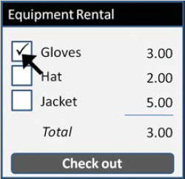
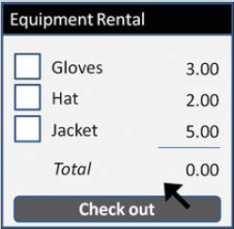
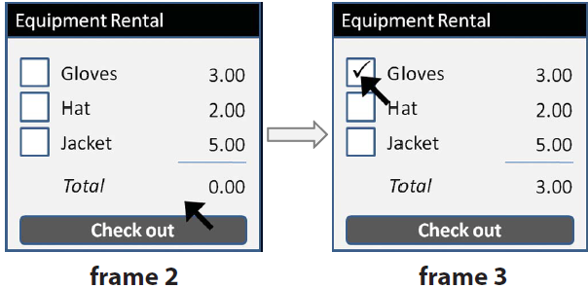
Problem: Discrete Movements
  breaks the feeling of
  continuous interaction

Slide 3
Motion Paths
Animates object movements along a path
Available in most presentation software
  powerpoint: motion paths
  keynote: move actions

Slide 4
Example: Moving the Cursor
Equipment Rental
Equipment Rental
Gloves
3.00

Gloves
3.00
Hat
2.00
Hat
2.00
Jacket
5.00
Jacket
5.00
Total
0.00
Total
3.00
Check out
Check out

Slide 5
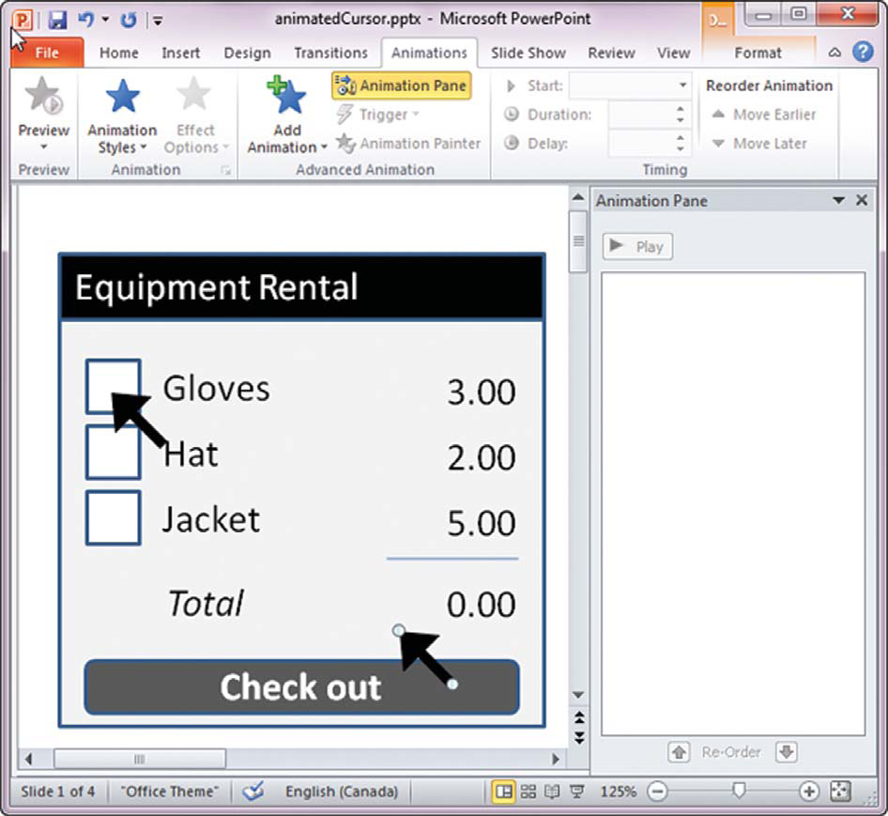
Example: Moving the Cursor
1. Specify final location of cursor
  copy cursor in Frame 3 to Frame 2
  select original cursor

Slide 6
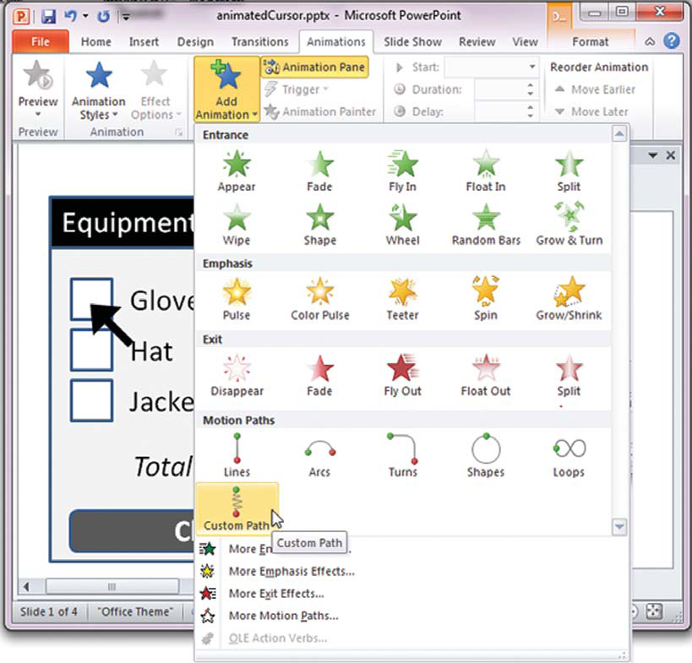
Example: Moving the Cursor
2. Select a motion path
  animation tab
  add animation
  custom paths

Slide 7
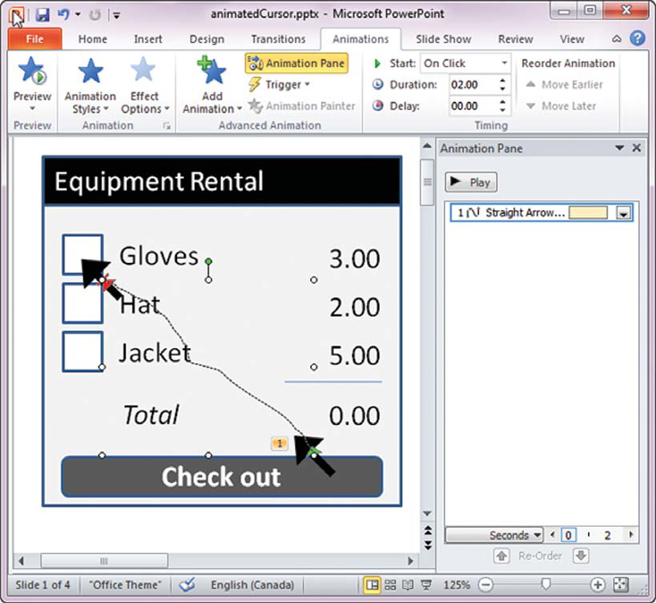
Example: Moving the Cursor
3. Create the motion path
  draw line from start to end position
  remove reference
  cursor

Slide 8
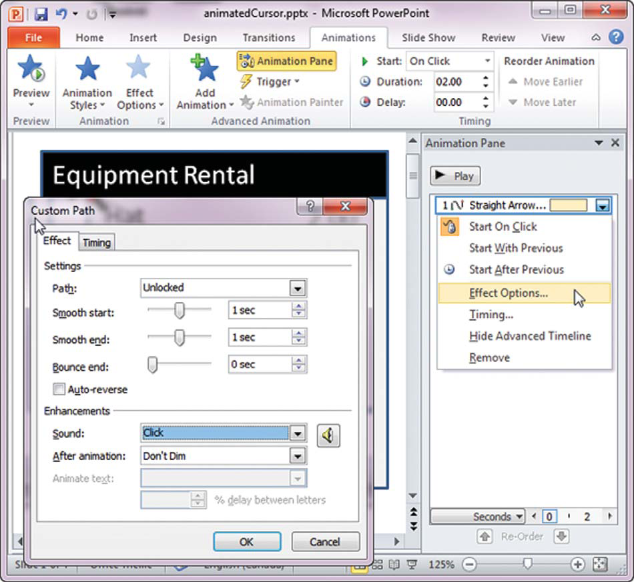
Example: Moving the Cursor
4. Add effects
  when animation starts
  speed of animation
  sounds…

Slide 9
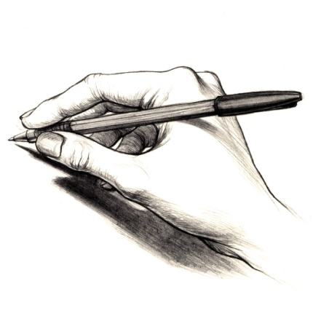
CrossY Prototype for Tablets
Inspired by the CrossY system: http://www.cs.umd.edu/hcil/crossy/ by Apitz and Guimbretiere

Slide 10
CrossY Prototype for Tablets – How?
Draw static elements
  color palette, line triangle
  drawn lines, rectangles colored to background white
Find hand drawing image
  clip art
  made white background transparent
Animate using motion paths
  Uncovering = drawing
    lines: underneath white rectangles
    motion paths of hand and rectangle are the same

Slide 11
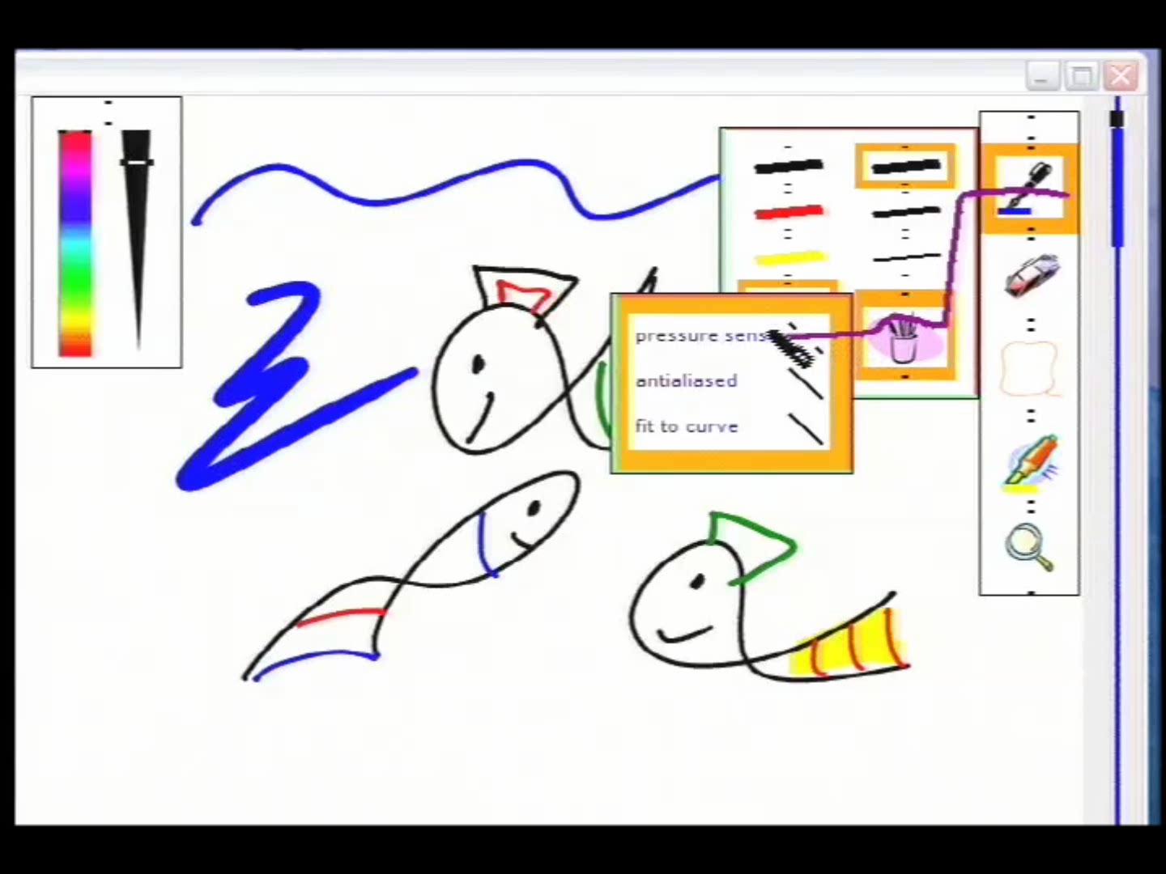
Excerpt from CrossY (UIST2004): http://www.acm.org/uist/archive/html/proceedings/2004.html#p3-apitz, by Apitz and Guimbretiere

Slide 12
You now know
Motion paths
  let you animate graphical objects
  increases viewer’s feeling of watching a movie
Image from:

Slide 13



Permissions
You are free:
  to Share — to copy, distribute and transmit the work
  to Remix — to adapt the work
Under the following conditions:
Attribution — You must attribute the work in the manner specified by the author (but not in any way that suggests that they endorse you or your use of the work) by citing:
  “from presentations accompanying the book ‘Sketching User Experiences, the Workbook’, by S. Greenberg, S. Carpendale, N. Marquardt and B. Buxton”
Noncommercial — You may not use this work for commercial purposes, except to assist one’s own teaching and training within commercial organizations.
Share Alike — If you alter, transform, or build upon this work, you may distribute the resulting work only under the same or similar license to this one.
With the understanding that:
Not all material have transferable rights — materials from other sources which are included here are cited
Waiver — Any of the above conditions can be waived if you get permission from the copyright holder.
Public Domain — Where the work or any of its elements is in the public domain under applicable law, that status is in no way affected by the license.
Other Rights — In no way are any of the following rights affected by the license:
  Your fair dealing or fair use rights, or other applicable copyright exceptions and limitations;
  The author's moral rights;
  Rights other persons may have either in the work itself or in how the work is used, such as publicity or privacy rights.
Notice — For any reuse or distribution, you must make clear to others the license terms of this work. The best way to do this is with a link to this web page.

