Slide 1
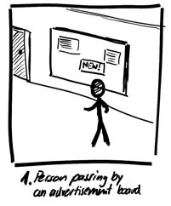
The Narrative Storyboard
Chapter 4.4 in Sketching User Experiences: The Workbook

Slide 2
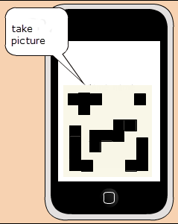
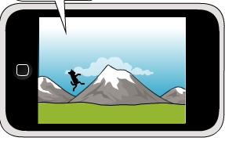
Interface vs. Narrative Storyboard

Slide 3
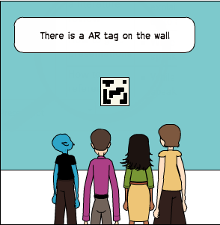
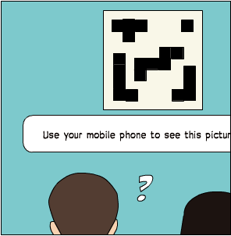
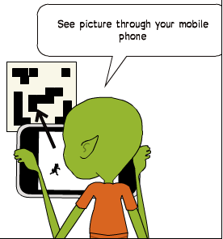
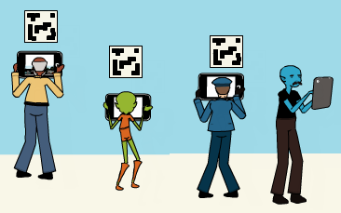
Image modified by S. Greenberg from: http://2012.idea9104.net/archives/1473 by yokoyokoyoko

Slide 4
A Narrative Tells a Story
The User Experience
  interface only part of the story
Narrative
  includes context of use
  a more complete story
Image modified by S. Greenberg from: http://2012.idea9104.net/archives/1473 by yokoyokoyoko

Slide 5
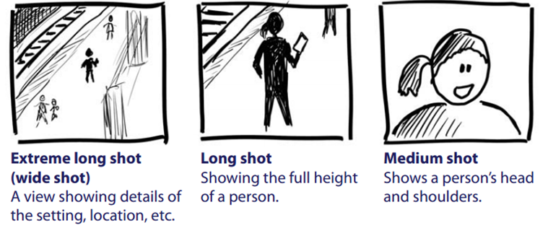
Vocabulary of Camera Shots

Slide 6
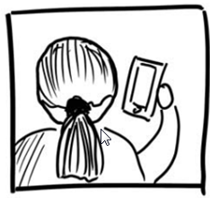
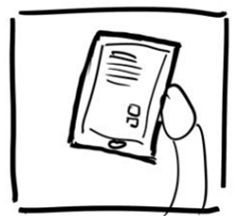


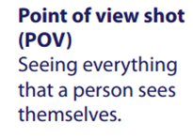
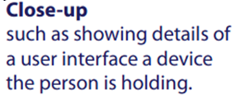
Vocabulary of Camera Shots
Image from:

Slide 7

1. Outline storyboard frames
5 boxes often suffice to illustrate one scenario
Image from:

Slide 8
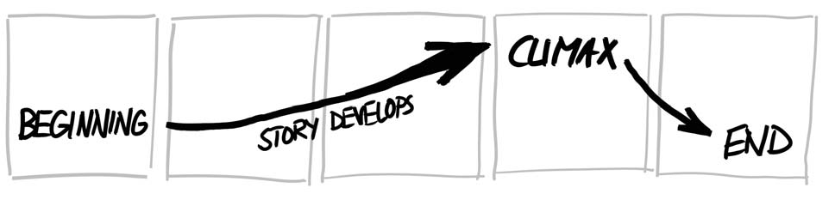
2. Develop the Storyline
Where does the interaction take place?
What is the problem?
What is the task a person is trying to do?
Which people are present / what are their actions?
What objects/devices do they use
What are the input / outputs?
How do their actions solve the problem?
Image from:

Slide 9
2. Develop the Storyline
establishing shot
story develops to climax
conclusion
Image from:

Slide 10
A Storyline
Fred passes by a public announcement board &
He is interested in more info about 1 announcement
He uses the phone to capture bar code next to display
He reads detailed info that appears on the phone
He walk away
Image from:

Slide 11
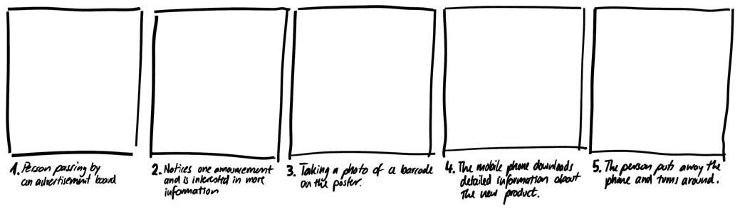
2. Develop the Storyline
1. A person passes by an advertisement board
3. Taking a photo of a barcode on the poster
5. Person puts phone away and turns around
2. Notices one advertisement and is interested in more information
4. Mobile phone downloads detailed info about that product
Image from:

Slide 12
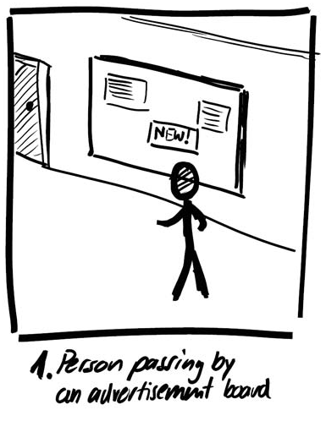
3. Sketch Establishing Shot
The introduction
  location where interaction
  takes place
  people involved
  setting
The shot
  long shot
Alternate shots OK
  hallway
  airport
  multiple people…
Image from:

Slide 13
3. Sketch Establishing Shot
Use appropriate shots
  extreme long shot
  emphasizes context
Image from:

Slide 14
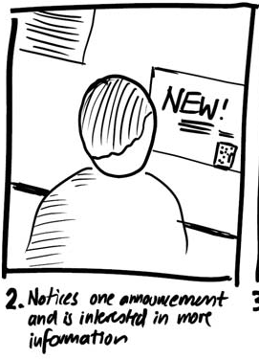
4. Continue storyline
Use appropriate shots
  over the shoulder
  emphasise person
  looking at something of
  interest
Image from:

Slide 15
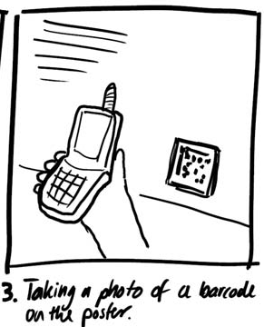
4. Continue storyline
Use appropriate shots
  point of view
  emphasises person’s
  action
Image from:

Slide 16
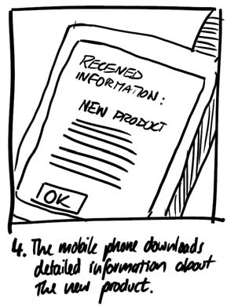
4. Continue storyline
Use appropriate shots
  close-up
  shows detail
The climax
Image from:

Slide 17
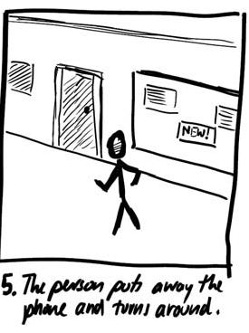
4. Continue storyline
Use appropriate shots
  extreme long shot
  shows context on
  completion
Conclusion
Image from:

Slide 18
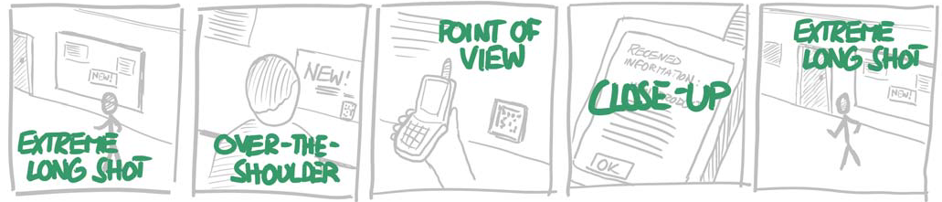
4. Continue storyline
Image from:

Slide 19
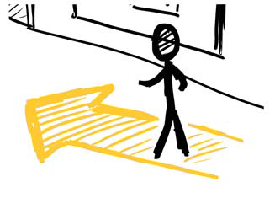
5. Emphasize Actions and Motions
Large arrow emphasises
a person walking by
Image from:

Slide 20
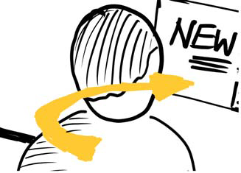

5. Emphasize Actions and Motions
Circling arrow emphasises
motion as he notices
something of interest
Question mark reveals emotions (interest)
Image from:

Slide 21
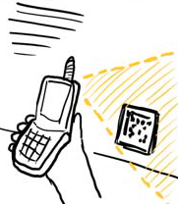
5. Emphasize Actions and Motions
Area emphasises
photo-taking action
Image from:

Slide 22

5. Emphasize Actions and Motions
Highlights emphasises
action of information received
Image from:

Slide 23
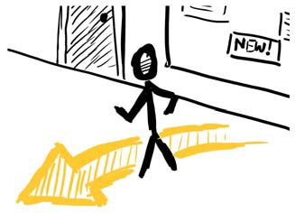
5. Emphasize Actions and Motions
Arrow emphasises
person walking away
Image from:

Slide 24
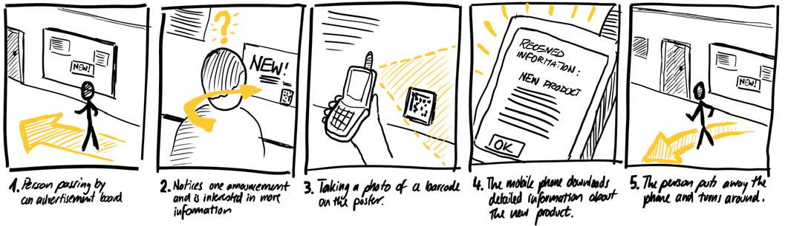
5. Emphasize Actions and Motions
Image from:

Slide 25
6. Demonstrate and Iterate
Show and get critique
  is it realistic?
  is the context plausible?
  are the person’s motivatins plausible
  would they really do those actions?
Develop alternate scenarios
Image from:

Slide 26
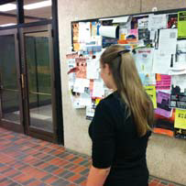
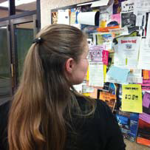
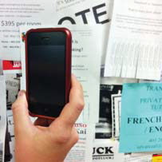
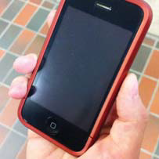
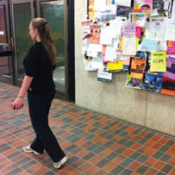
Alternate
Steps 3+4. Use Snapshots Instead
Tip: exaggerate poses

Slide 27
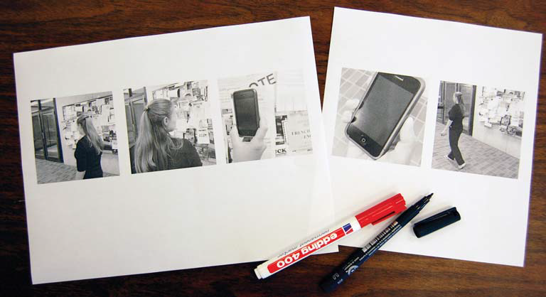
Alternate
Print Them
Tip: 4”x4” minimum / photo

Slide 28
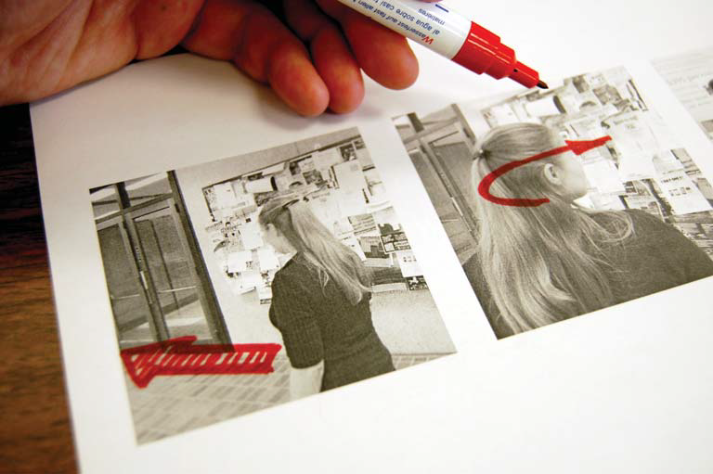
Alternate
Annotate Them
Tip: thick markers / tracing paper for alternates

Slide 29
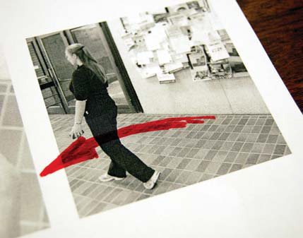
Alternate
Annotate Them
Tip: annotations an extend beyond boundaries

Slide 30
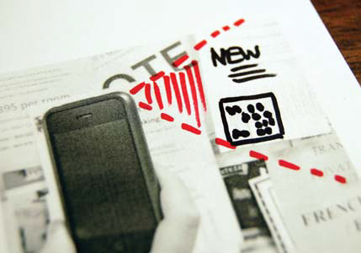
Alternate
Draw additional elements
Tip: Leave space on photos / white it out, or…

Slide 31
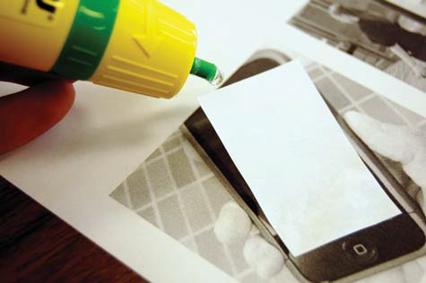
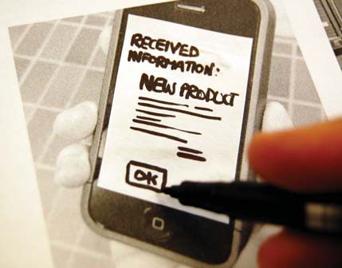
Alternate
Draw additional elements
Tip: Use office supplies to create overlays

Slide 32
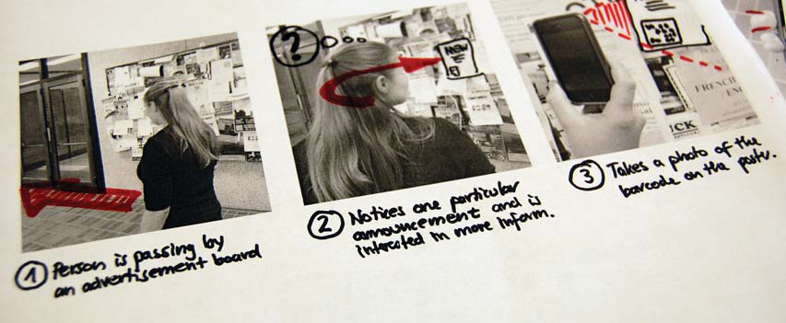
Alternate
Add Storyline

Slide 33
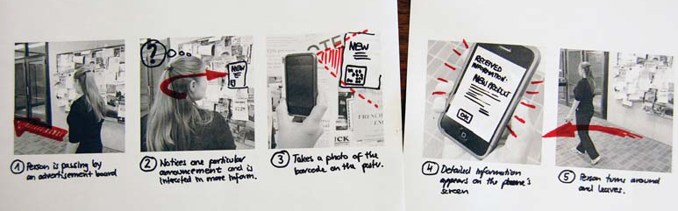
Alternate
Complete Narrative Storyboard

Slide 34
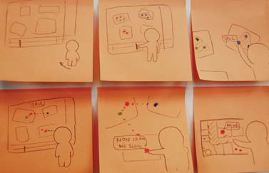
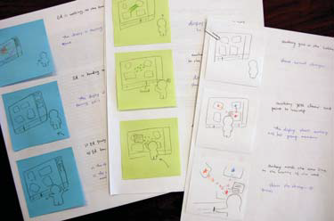
Tip
Use Sticky Notes for your Frames
Easier to
  add
  subtract
  modify
  alternatives

Slide 35
You now know
Vocabulary of shots
Narratives
  develop a story
  illustrate context of interaction
    from beginning to climax to conclusion
Narratives can be composed from
  sketches and/or photos
  annotations and explanatory notes

Slide 36



Permissions
You are free:
  to Share — to copy, distribute and transmit the work
  to Remix — to adapt the work
Under the following conditions:
Attribution — You must attribute the work in the manner specified by the author (but not in any way that suggests that they endorse you or your use of the work) by citing:
  “from presentations accompanying the book ‘Sketching User Experiences, the Workbook’, by S. Greenberg, S. Carpendale, N. Marquardt and B. Buxton”
Noncommercial — You may not use this work for commercial purposes, except to assist one’s own teaching and training within commercial organizations.
Share Alike — If you alter, transform, or build upon this work, you may distribute the resulting work only under the same or similar license to this one.
With the understanding that:
Not all material have transferable rights — materials from other sources which are included here are cited
Waiver — Any of the above conditions can be waived if you get permission from the copyright holder.
Public Domain — Where the work or any of its elements is in the public domain under applicable law, that status is in no way affected by the license.
Other Rights — In no way are any of the following rights affected by the license:
  Your fair dealing or fair use rights, or other applicable copyright exceptions and limitations;
  The author's moral rights;
  Rights other persons may have either in the work itself or in how the work is used, such as publicity or privacy rights.
Notice — For any reuse or distribution, you must make clear to others the license terms of this work. The best way to do this is with a link to this web page.

