Slide 1
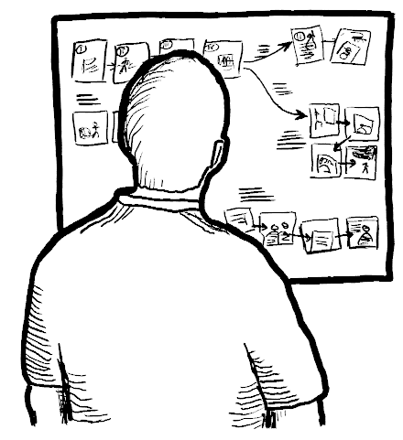
The Branching Storyboard
Chapter 4.3 in Sketching the User Interface: The Workbook
Image from:

Slide 2
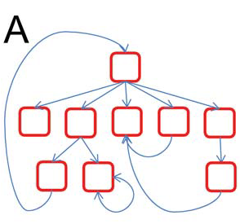
Storyboards will Contain Branches
Multiple transitions from a state
Result of
  user actions
  environmental actions
  system configuration…
Image from: Anderson et. Al. Buttress. Usenix Fast ‘04

Slide 3
Exercise
Your digital (or cell phone)
Construct state transition diagrams to
  capture a simple branching sequential operation
  illustrates the techniques of
    abstract diagram
    visual interface diagram
    indexed diagram

Slide 4
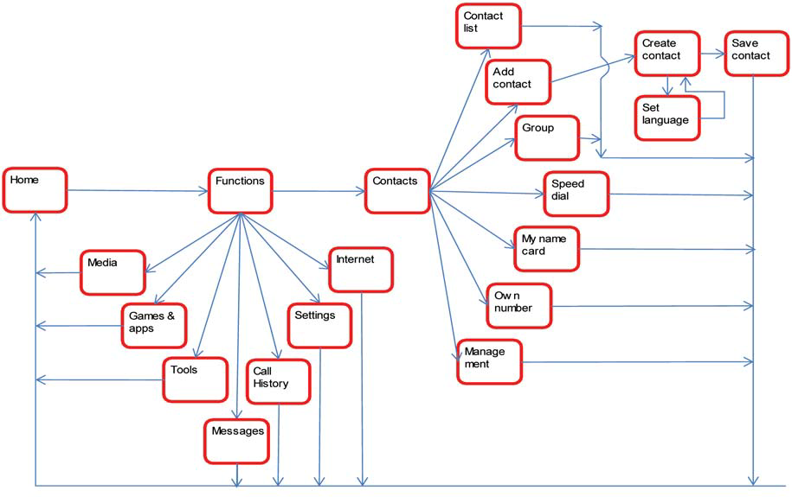
The Abstract Branching Diagram

Slide 5
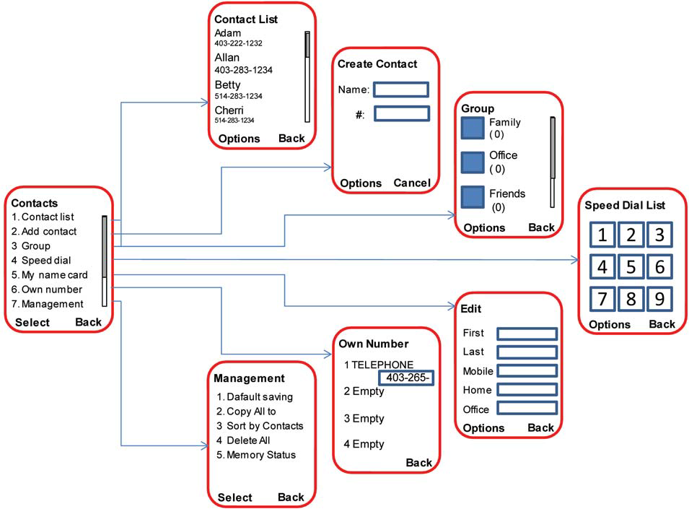
Visual Interface Branching Diagram

Slide 6
Visual Interface Branching Diagram
By interface hot spots…
Computer Telephone
Last Name:
First Name:
Phone:
Help
Computer Telephone
You can enter either the
Place Call
Help
person's name or their
Last Name:
number. Then hit the
First Name:
place button to call them
Phone:
Place Call
Help
Return
Computer Telephone
Computer Telephone
Last Name:
Greenberg
Dialling....
First Name:
Last Name: Greenberg
Phone:
First Name:
Phone:
Cancel
Place Call
Help
Place Call
Help

Slide 7
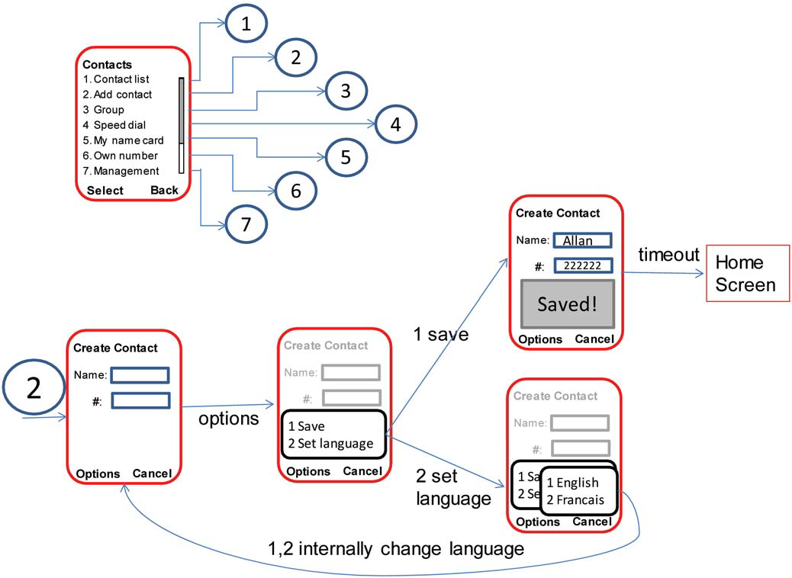
Indexed Branching Diagram

Slide 8
Indexed Branching Diagram

Slide 9
The Catalog Shopping System - see chapter 4.1
Brick and mortar store
  paper catalogs
  scan in desired item(s) with bar code reader
  see item on computer screen
  complete and pay for order (which submits it)
  print it and bring to sales clerk
  sales clerk gives you item
Storyboard
  buy a blue stroller

Slide 10
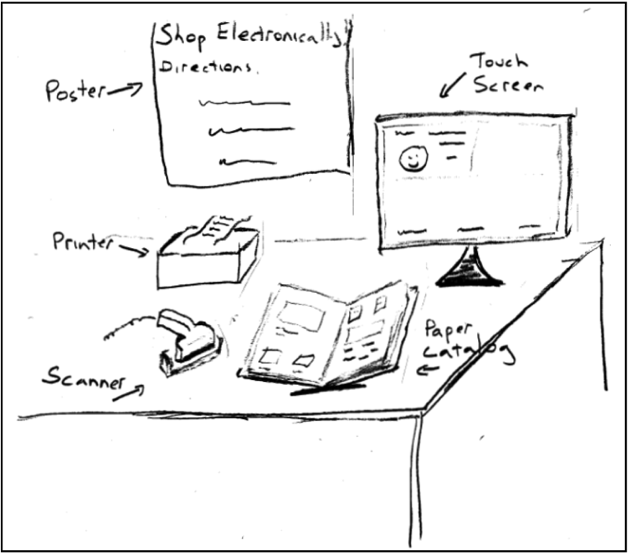

Slide 11
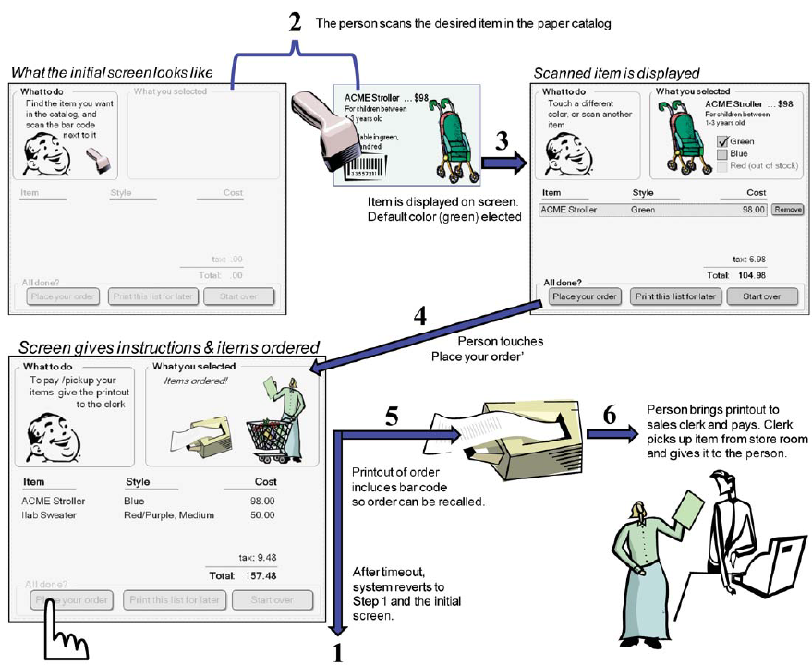

Slide 12
The Catalog Shopping System
Extend it to allow a person to
  scan 2 or more items
  modify items in the list
  print out the list, then come back later and scan in the list
  not buy anything
    walk away
    explitely cancel the order

Slide 13
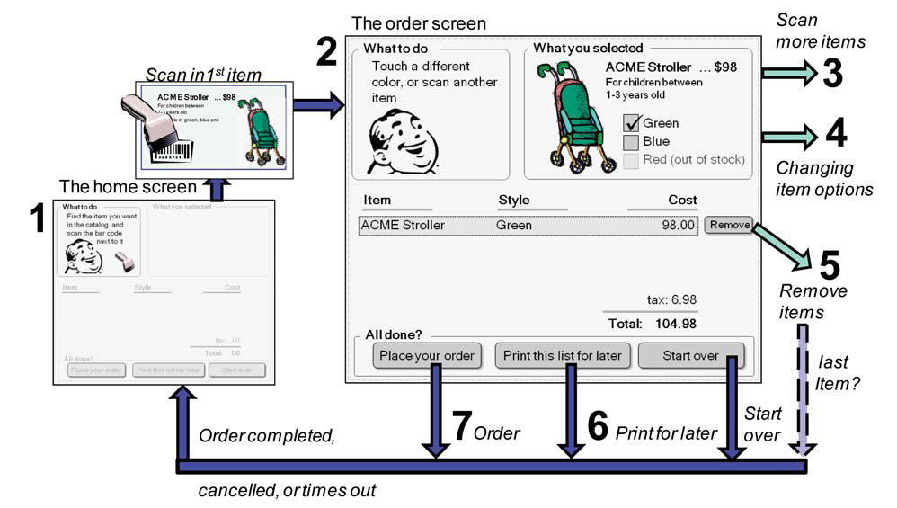
Overview Map – The Basic Operation

Slide 14
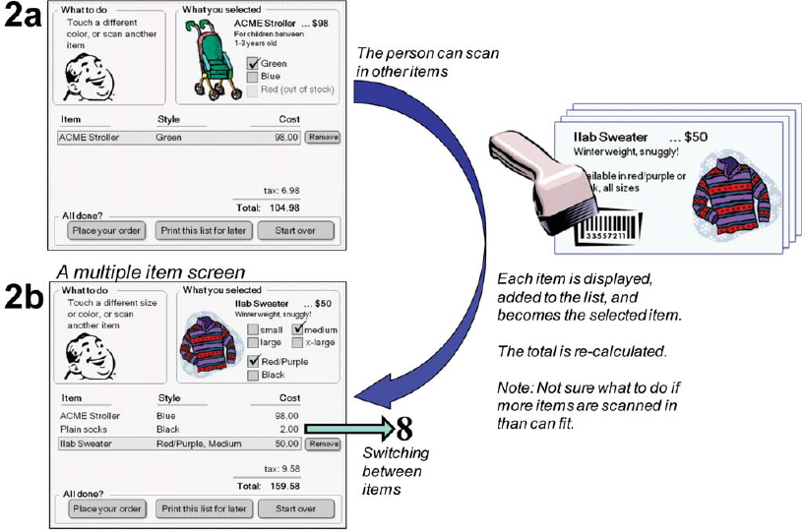
2 Scanning in Multiple Items

Slide 15
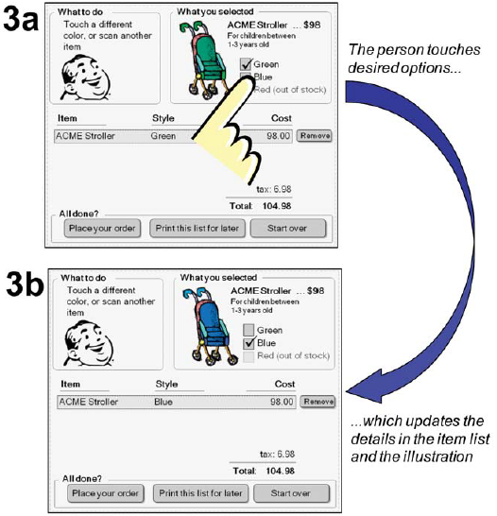
3 Changing item options

Slide 16
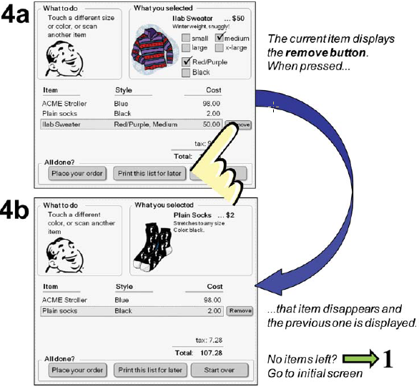
4 removing items

Slide 17
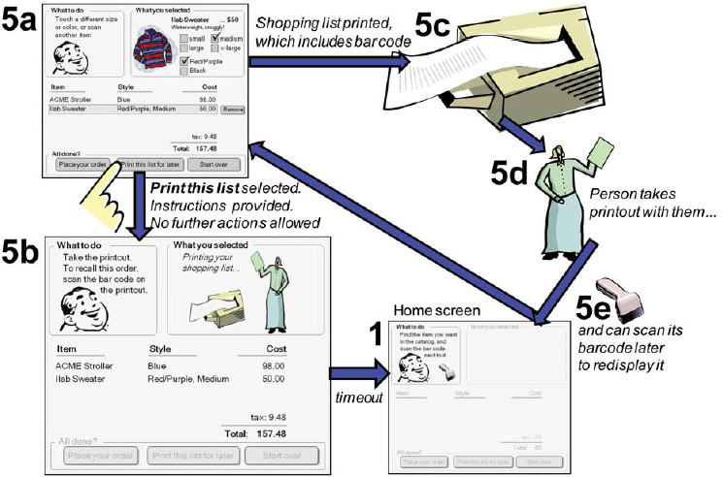
5 print for later

Slide 18
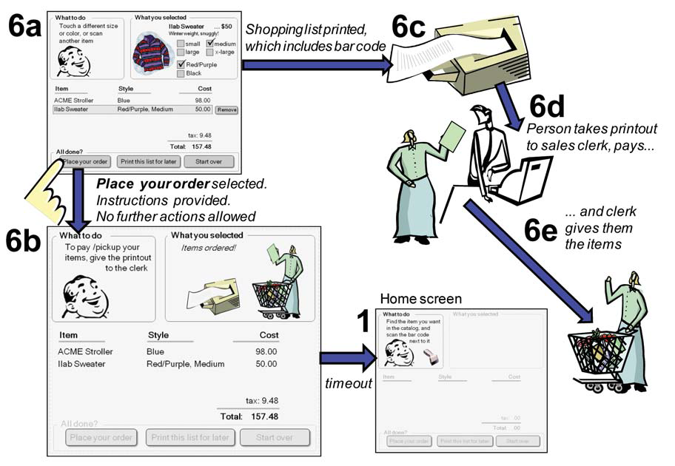
6 Place order

Slide 19
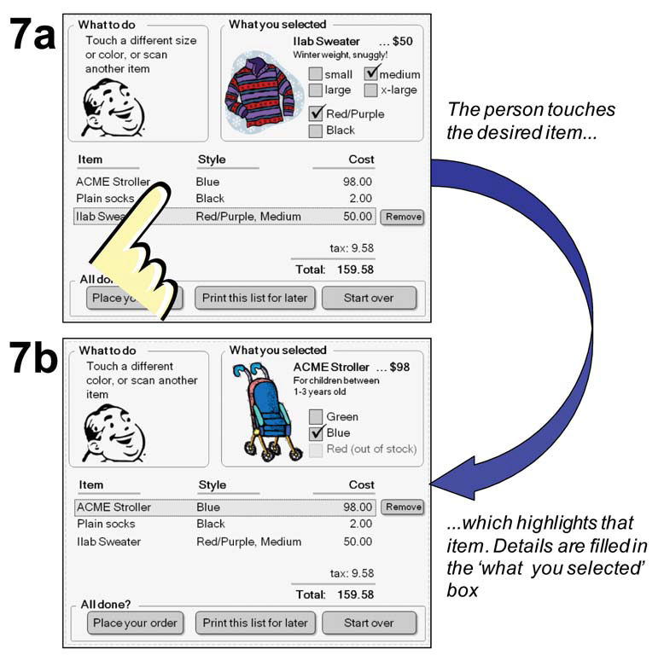
7 Switching between items

Slide 20
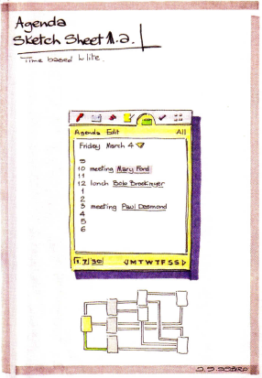
Interacting with a PDA-based Agenda
Bill Buxton Sketching User Experiences, Morgan Kaufman Figure 99, p 284

Slide 21
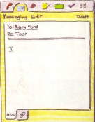
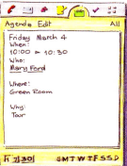
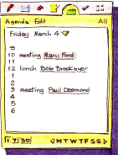
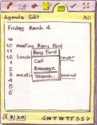
Interacting with a PDA-based Agenda
Bill Buxton Sketching User Experiences, Morgan Kaufman Figure 99, p 284

Slide 22
Interacting with a PDA-based Agenda
The Overview map
(where are we?)
Bill Buxton Sketching User Experiences, Morgan Kaufman Figure 99, p 284

Slide 23
Interacting with a PDA-based Agenda
Looking at the agenda and seeing that there is a 10am meeting with someone named Mary Ford
Bill Buxton Sketching User Experiences, Morgan Kaufman Figure 99, p 284

Slide 24
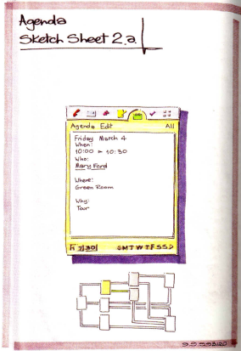
Check to see what the meeting is about
Click on that time slot
Bill Buxton Sketching User Experiences, Morgan Kaufman Figure 99, p 284

Slide 25
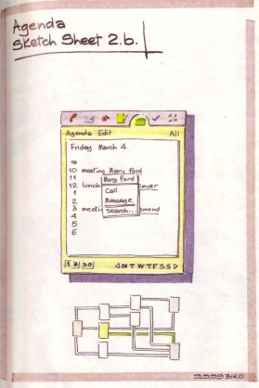
Choosing how to contact Mary
Click on Mary’s name
Bill Buxton Sketching User Experiences, Morgan Kaufman Figure 99, p 284

Slide 26
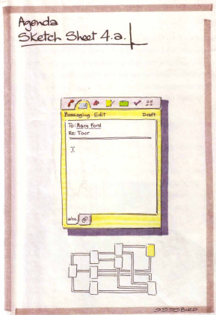
Sending Mary a text message concering the ‘Tour’ which is the topic of the meeting
Select Message from menu
Bill Buxton Sketching User Experiences, Morgan Kaufman Figure 99, p 284

Slide 27
Click on that time slot
Click on Mary’s name
Select Message
Bill Buxton Sketching User Experiences, Morgan Kaufman Figure 99, p 284

Slide 28
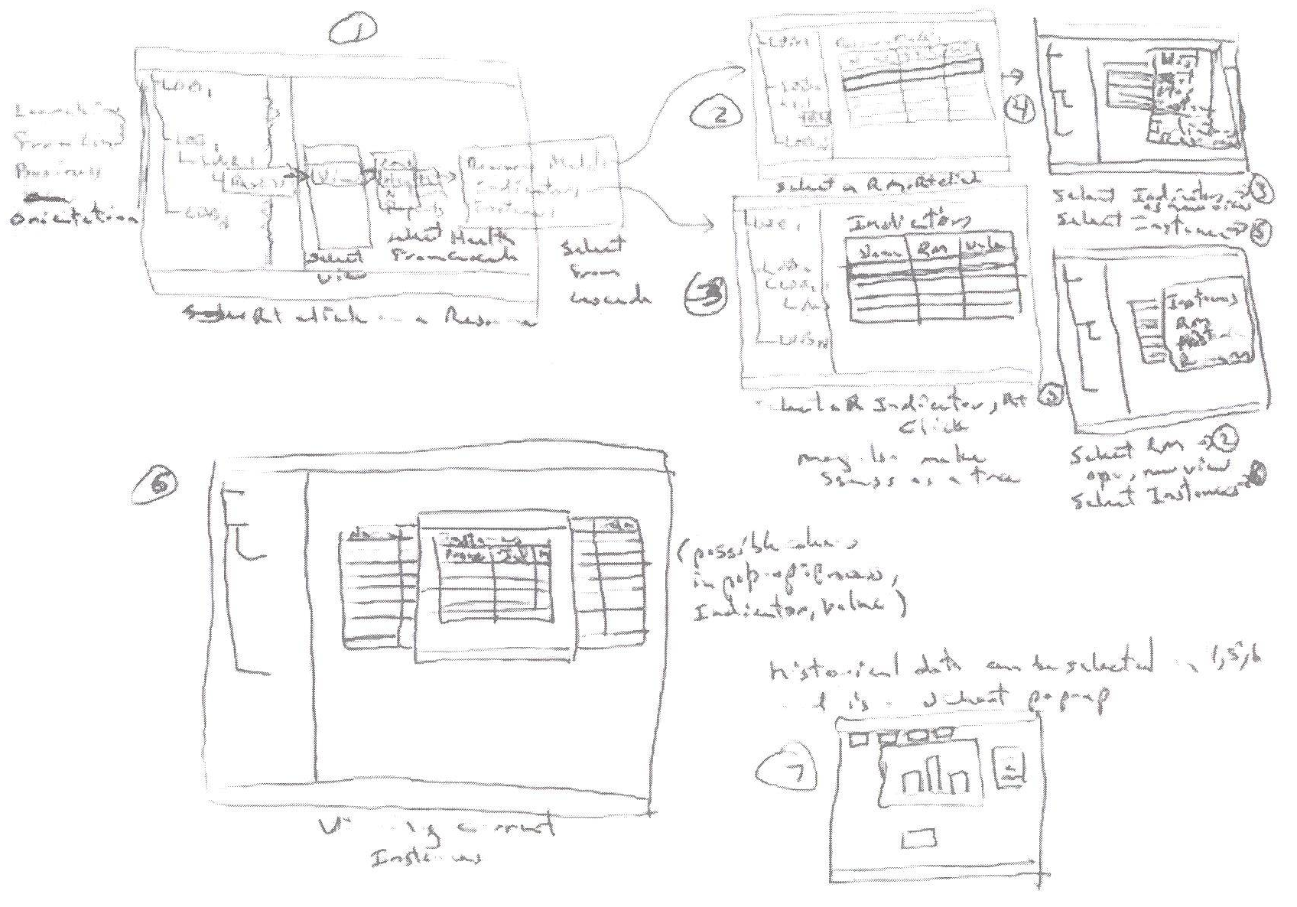
¹From Carloyn Snyder’s Book Paper Prototyping (2003) Morgan Kaufmann, p11

Slide 29
You Now Know
Branching storyboards
  multiple transitions from a state
  illustrate decision paths
  manage complexity
  can be decomposed to sequential storyboards or simple branching storyboards

Slide 30



Permissions
You are free:
  to Share — to copy, distribute and transmit the work
  to Remix — to adapt the work
Under the following conditions:
Attribution — You must attribute the work in the manner specified by the author (but not in any way that suggests that they endorse you or your use of the work) by citing:
  “from presentations accompanying the book ‘Sketching User Experiences, the Workbook’, by S. Greenberg, S. Carpendale, N. Marquardt and B. Buxton”
Noncommercial — You may not use this work for commercial purposes, except to assist one’s own teaching and training within commercial organizations.
Share Alike — If you alter, transform, or build upon this work, you may distribute the resulting work only under the same or similar license to this one.
With the understanding that:
Not all material have transferable rights — materials from other sources which are included here are cited
Waiver — Any of the above conditions can be waived if you get permission from the copyright holder.
Public Domain — Where the work or any of its elements is in the public domain under applicable law, that status is in no way affected by the license.
Other Rights — In no way are any of the following rights affected by the license:
  Your fair dealing or fair use rights, or other applicable copyright exceptions and limitations;
  The author's moral rights;
  Rights other persons may have either in the work itself or in how the work is used, such as publicity or privacy rights.
Notice — For any reuse or distribution, you must make clear to others the license terms of this work. The best way to do this is with a link to this web page.

